Slide 1
Chapter 7 Rate of Convergence
李钊佚
2021/12/27

Slide 2
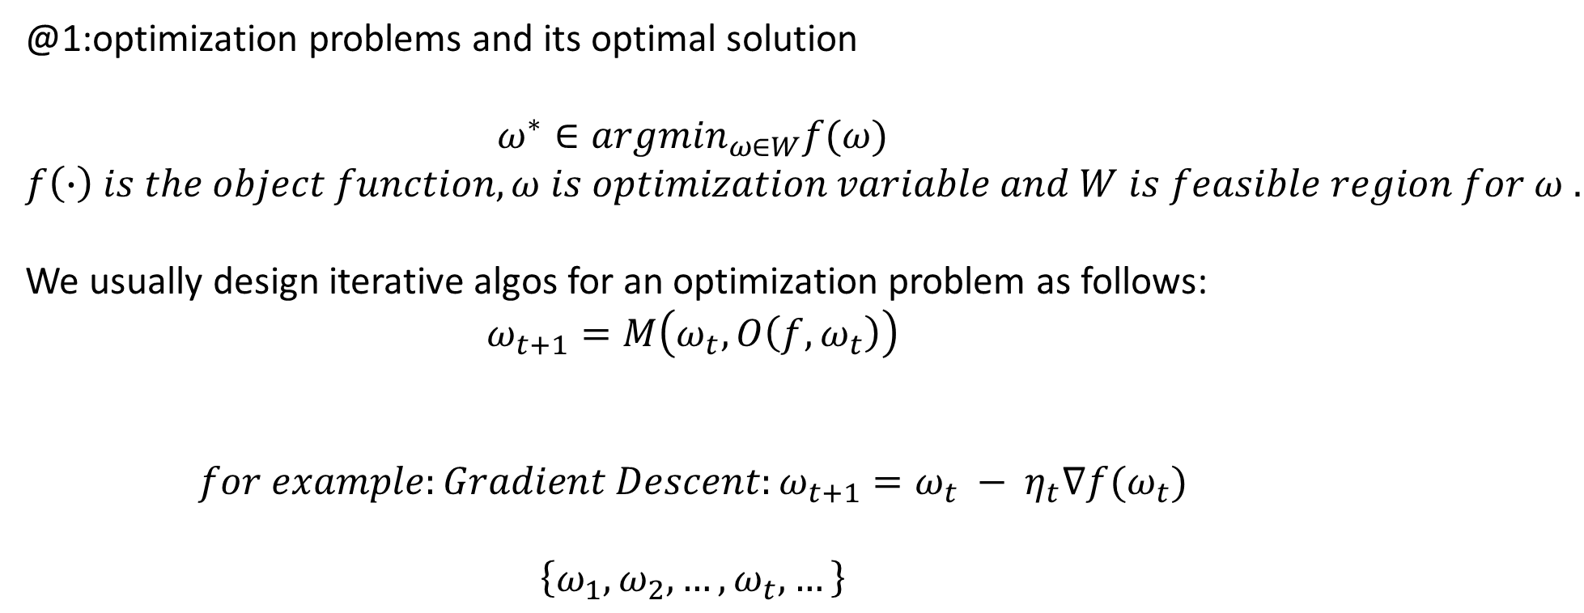
Basic Concepts and Notations
@1:optimization problems and its optimal solution
$$ω^{∗}∈{argmin}_{ω∈W}f(ω)$$
$$f\left(∙\right) is the object function, ω is optimization variable and W is feasible region for ω .$$
We usually design iterative algos for an optimization problem as follows:
$$ω_{t+1}=M\left(ω_{t},O\left(f, ω_{t}\right)\right)$$
$$for example:Gradient Descent:ω_{t+1}=ω_{t} − η_{t}∇f(ω_{t})$$
$$\left\{ω_{1},ω_{2},…,ω_{t},…\right\}$$
Update policy
Oracles

Slide 3
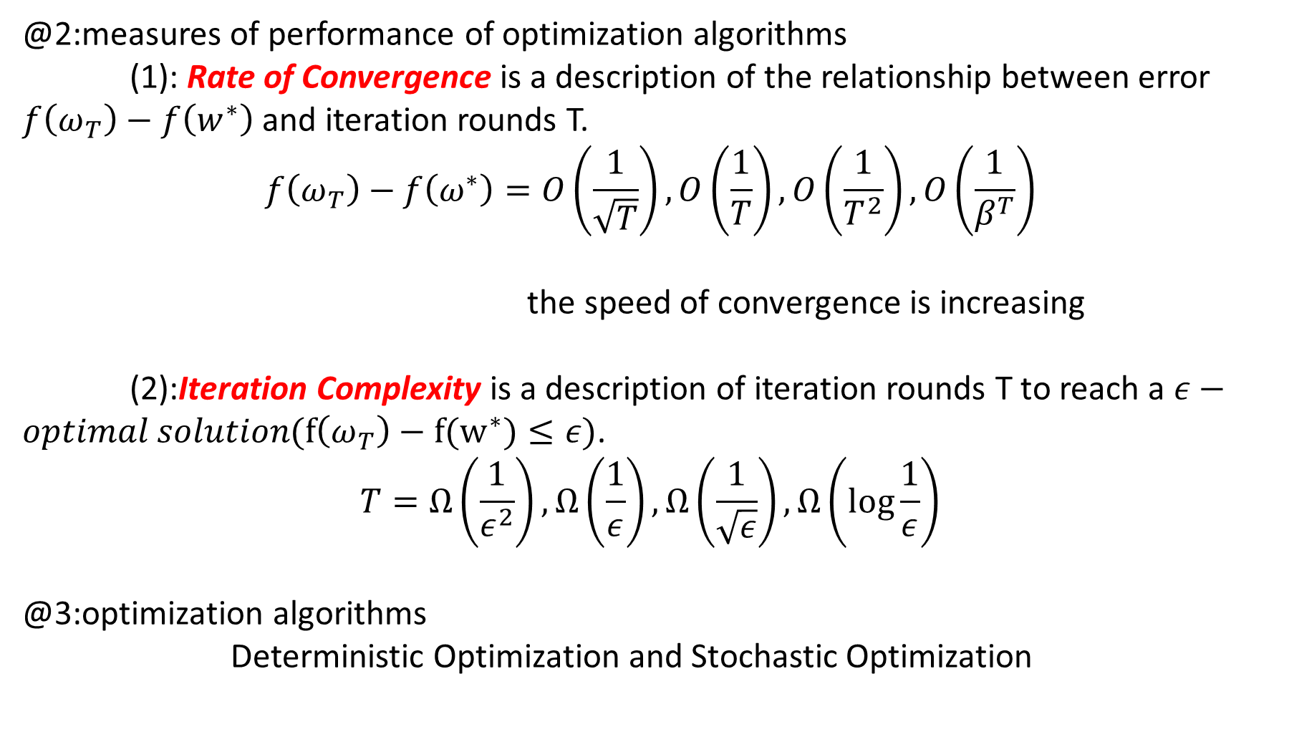
@2:measures of performance of optimization algorithms
(1): Rate of Convergence is a description of the relationship between error $f\left(ω_{T}\right)−f\left(w^{∗}\right)$ and iteration rounds T.
$$f\left(ω_{T}\right)−f\left(ω^{∗}\right)=O\left(\frac{1}{\sqrt{T}}\right), O\left(\frac{1}{T}\right), O\left(\frac{1}{T^{2}}\right),O\left(\frac{1}{β^{T}}\right)$$
the speed of convergence is increasing
(2):Iteration Complexity is a description of iteration rounds T to reach a $ε−optimal solution(f\left(ω_{T}\right)−f(w^{∗})≤ε)$.
$$T=Ω\left(\frac{1}{ε^{2}}\right),Ω\left(\frac{1}{ε}\right),Ω\left(\frac{1}{\sqrt{ε}}\right),Ω\left(\log{\frac{1}{ε}}\right)$$
@3:optimization algorithms
Deterministic Optimization and Stochastic Optimization

Slide 4
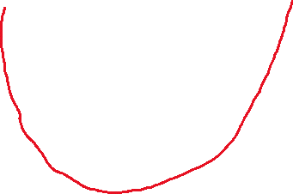


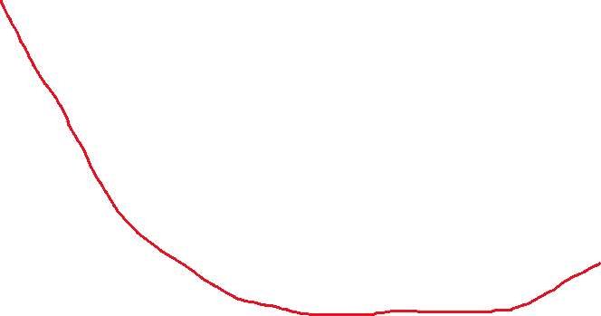
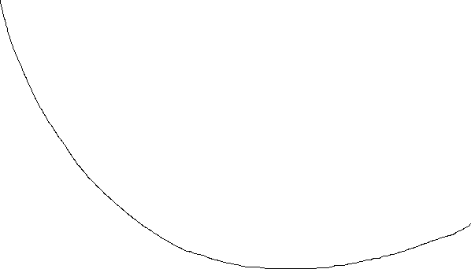

@4: backgrounds
$$\left(1\right)convex function$$
$$∀x_{1},x_{2}∈W, we have that f\left(x_{2}\right)≥f\left(x_{1}\right)+∇f(x_{1})∙(x_{2}−x_{1})$$
$$\left(2\right)λ−strong convex function$$
$$∀x_{1},x_{2}∈W, we have that f\left(x_{2}\right)≥f\left(x_{1}\right)+∇f\left(x_{1}\right)∙\left(x_{2}−x_{1}\right)+\frac{λ}{2}{\left\|x_{2}−x_{1}\right\|}^{2}$$
$$\left(3\right)l−Lipschitz continous$$
$$∀x_{1},x_{2}∈W,we have that f\left(x_{1}\right)−f(x_{2})≤l\left|x_{1}−x_{2}\right|$$
$$\left(4\right)γ−smooth$$
$$∀x_{1},x_{2}∈W,we have that f\left(x_{2}\right)≤f\left(x_{1}\right)+∇f\left(x_{1}\right)∙\left(x_{2}−x_{1}\right)+\frac{γ}{2}{\left\|x_{2}−x_{1}\right\|}^{2}$$
$$γ−smooth:upper bound$$
$$λ−strongly convex:lower bound$$

Slide 5
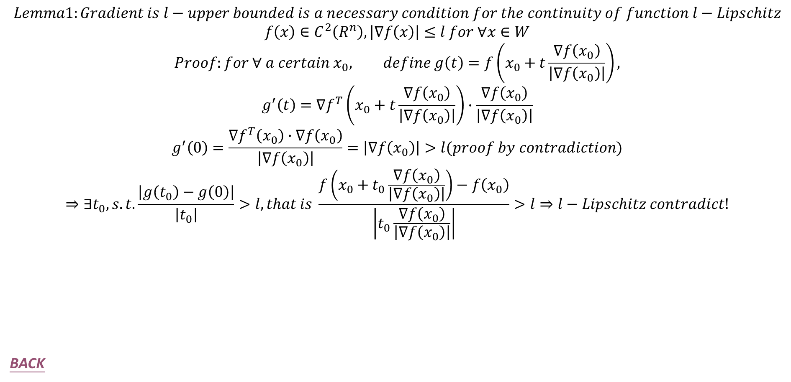
$$Lemma1:Gradient is l−upper bounded is a necessary condition for the continuity of function l−Lipschitz$$
$$f\left(x\right)∈C^{2}\left(R^{n}\right),\left|∇f\left(x\right)\right|≤l for ∀x∈W$$
$$Proof:for ∀ a certain x_{0}, define g\left(t\right)=f\left(x_{0}+t\frac{∇f\left(x_{0}\right)}{\left|∇f\left(x_{0}\right)\right|}\right),$$
$$g^{′}\left(t\right)=∇f^{T}\left(x_{0}+t\frac{∇f\left(x_{0}\right)}{\left|∇f\left(x_{0}\right)\right|}\right)∙\frac{∇f\left(x_{0}\right)}{\left|∇f\left(x_{0}\right)\right|}$$
$$g^{′}\left(0\right)=\frac{∇f^{T}\left(x_{0}\right)∙∇f\left(x_{0}\right)}{\left|∇f\left(x_{0}\right)\right|}=\left|∇f\left(x_{0}\right)\right|>l(proof by contradiction)$$
$$⇒∃t_{0}, s.t.\frac{\left|g\left(t_{0}\right)−g\left(0\right)\right|}{\left|t_{0}\right|}>l,that is \frac{f\left(x_{0}+t_{0}\frac{∇f\left(x_{0}\right)}{\left|∇f\left(x_{0}\right)\right|}\right)−f\left(x_{0}\right)}{\left|t_{0}\frac{∇f\left(x_{0}\right)}{\left|∇f\left(x_{0}\right)\right|}\right|}>l⇒l−Lipschitz contradict!$$
BACK

Slide 6
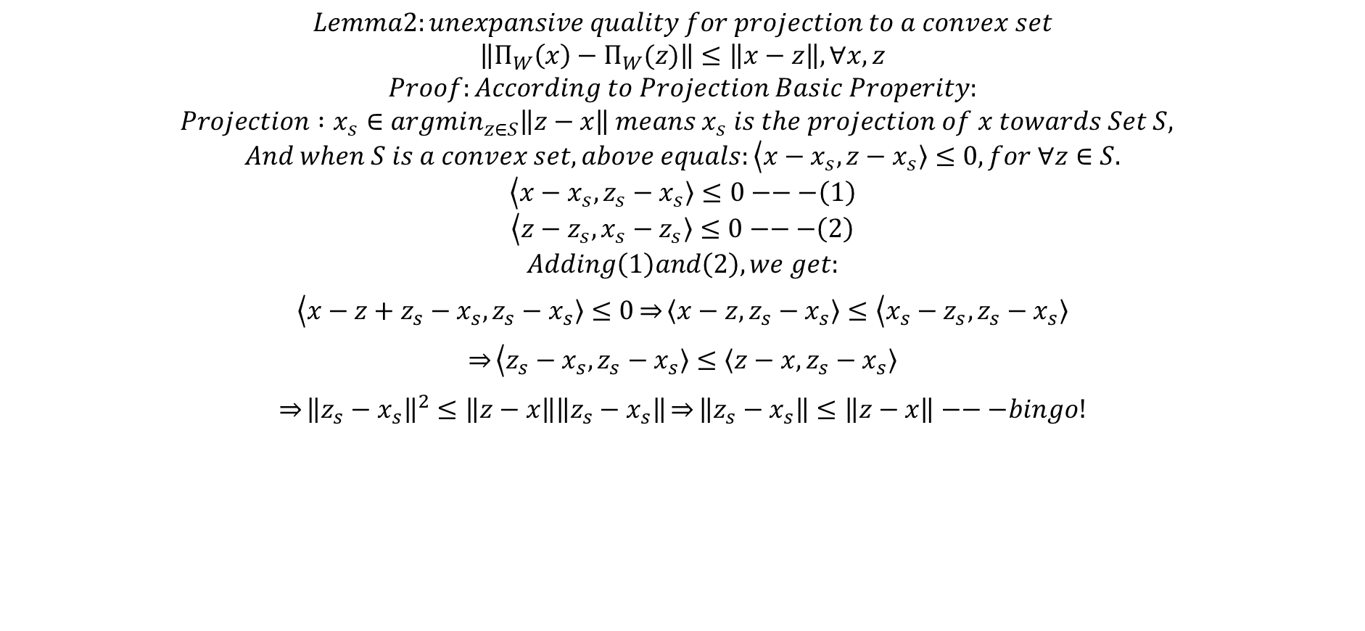
$$Lemma2:unexpansive quality for projection to a convex set$$
$$\left\|Π_{W}\left(x\right)−Π_{W}(z)\right\|≤\left\|x−z\right\|, ∀x,z$$
$$Proof:According to Projection Basic Properity:$$
$$Projection :x_{s}∈argmin_{z∈S}\left\|z−x\right\| means x_{s} is the projection of x towards Set S,$$
$$And when S is a convex set, above equals:\left\langle x−x_{s}\right.,\left.z−x_{s}\right\rangle ≤0,for ∀z∈S.$$
$$\left\langle x−x_{s}\right.,\left.z_{s}−x_{s}\right\rangle ≤0−−−\left(1\right)$$
$$\left\langle z−z_{s}\right.,\left.x_{s}−z_{s}\right\rangle ≤0−−−\left(2\right)$$
$$Adding\left(1\right)and\left(2\right),we get:$$
$$\left\langle x−{z+z_{s}−x}_{s}\right.,\left.z_{s}−x_{s}\right\rangle ≤0\underset{⇒}{}\left\langle x−z\right.,\left.z_{s}−x_{s}\right\rangle ≤\left\langle x_{s}−z_{s}\right.,\left.z_{s}−x_{s}\right\rangle$$
$$\underset{⇒}{}\left\langle z_{s}−x_{s}\right.,\left.z_{s}−x_{s}\right\rangle ≤\left\langle z−x\right.,\left.z_{s}−x_{s}\right\rangle$$
$$\underset{⇒}{}{\left\|z_{s}−x_{s}\right\|}^{2}≤\left\|z−x\right\|\left\|z_{s}−x_{s}\right\|\underset{⇒}{}\left\|z_{s}−x_{s}\right\|≤\left\|z−x\right\|−−−bingo!$$
BACK

Slide 7
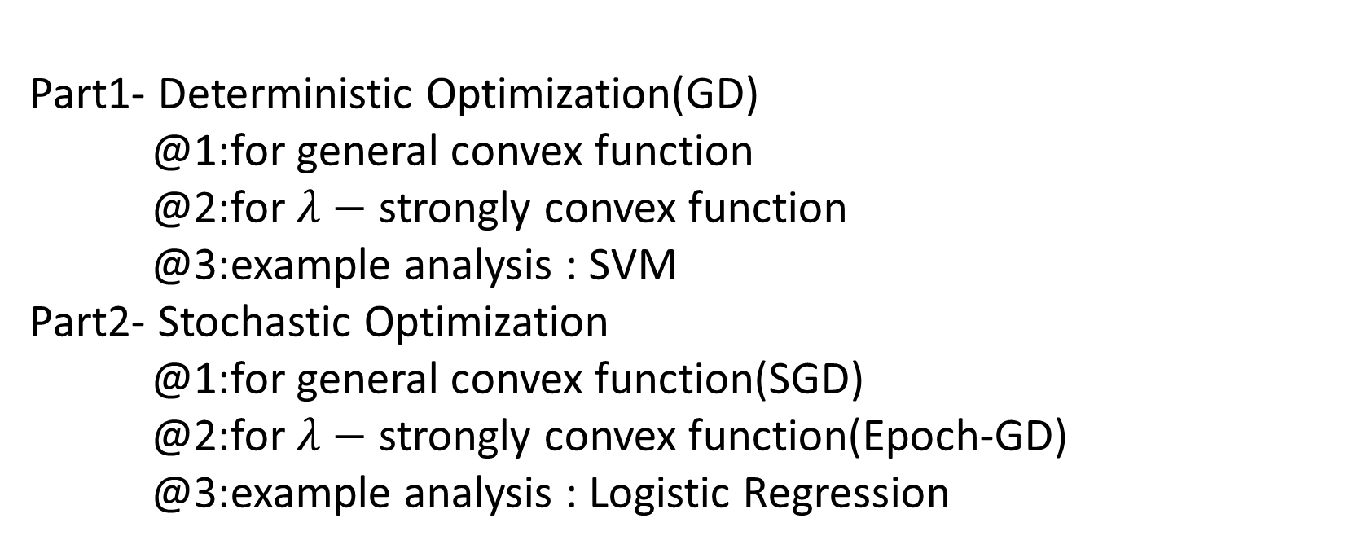
Synopsis
Part1- Deterministic Optimization(GD)
@1:for general convex function
@2:for $λ−$ strongly convex function
@3:example analysis : SVM
Part2- Stochastic Optimization
@1:for general convex function(SGD)
@2:for $λ−$ strongly convex function(Epoch-GD)
@3:example analysis : Logistic Regression

Slide 8
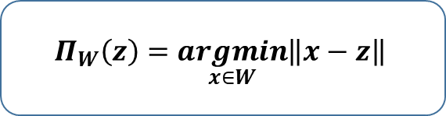
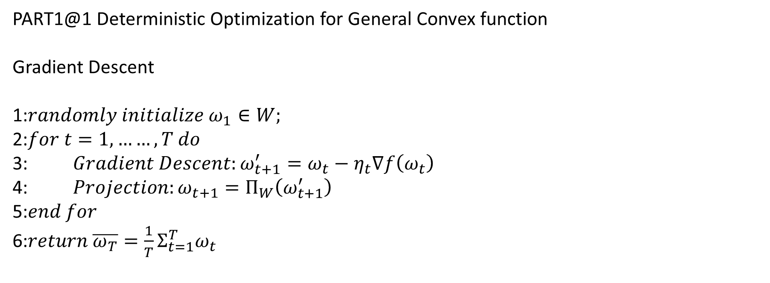
PART1@1 Deterministic Optimization for General Convex function
Gradient Descent
1:$randomly initialize ω_{1}∈W;$
2:$for t=1,……,T do$
3: $Gradient Descent:ω_{t+1}^{′}=ω_{t}−η_{t}∇f\left(ω_{t}\right)$
4: $Projection:ω_{t+1}=Π_{W}\left(ω_{t+1}^{′}\right)$
5:$end for$
6:$return \overline{ω_{T}}=\frac{1}{T}Σ_{t=1}^{T}ω_{t}$
$$Π_{W}\left(z\right)=\underset{x∈W}{argmin}\left\|x−z\right\|$$

Slide 9
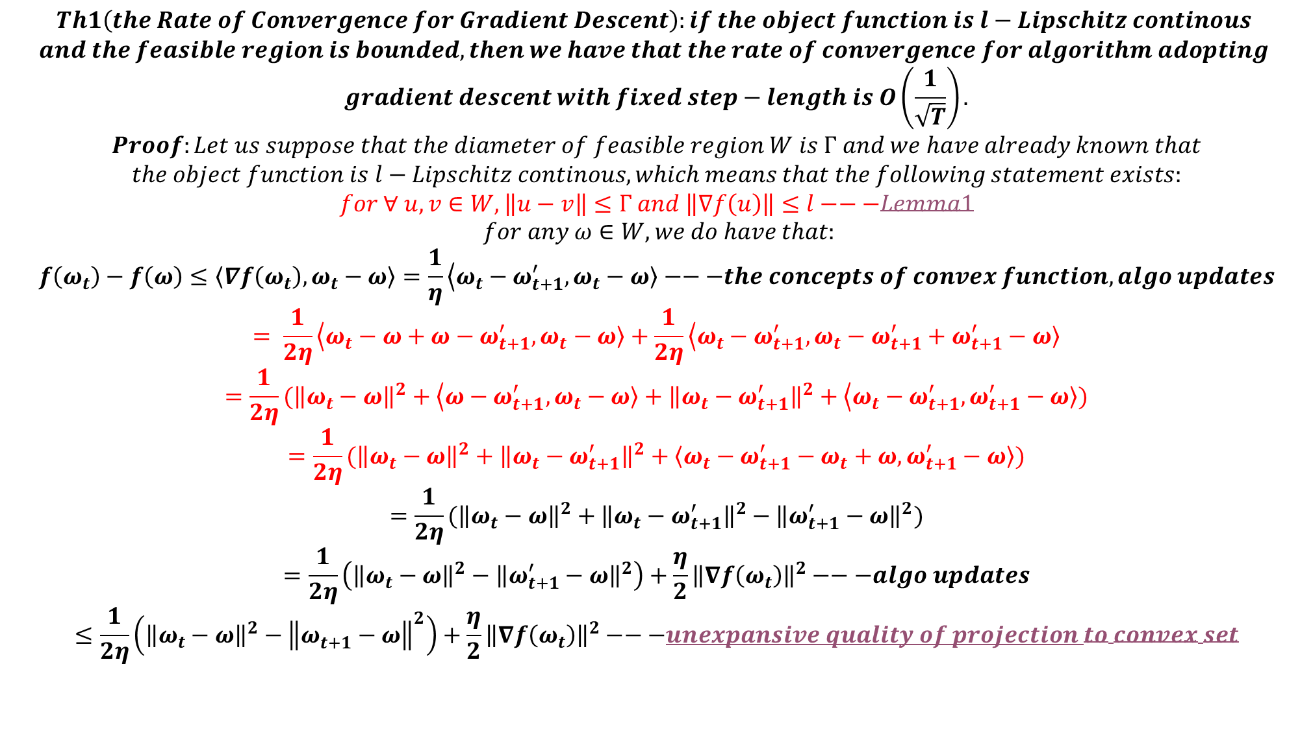
$$Th1\left(the Rate of Convergence for Gradient Descent\right):if the object function is l−Lipschitz continous$$
$$and the feasible region is bounded, then we have that the rate of convergence for algorithm adopting$$
$$gradient descent with fixed step−length is O\left(\frac{1}{\sqrt{T}}\right).$$
$$Proof:Let us suppose that the diameter of feasible region W is Γ and we have already known that$$
$$the object function is l−Lipschitz continous, which means that the following statement exists:$$
$$for ∀ u,v∈W,\left\|u−v\right\|≤Γ and \left\|∇f\left(u\right)\right\|≤l−−−Lemma1$$
$$for any ω∈W, we do have that:$$
$$f\left(ω_{t}\right)−f\left(ω\right)≤\left\langle ∇f\left(ω_{t}\right)\right.,\left.ω_{t}−ω\right\rangle =\frac{1}{η}\left\langle ω_{t}−ω_{t+1}^{′}\right.,\left.ω_{t}−ω\right\rangle −−−the concepts of convex function,algo updates$$
$$= \frac{1}{2η}\left\langle ω_{t}−ω+ω−ω_{t+1}^{′}\right.,\left.ω_{t}−ω\right\rangle +\frac{1}{2η}\left\langle ω_{t}−ω_{t+1}^{′}\right.,\left.ω_{t}−ω_{t+1}^{′}+ω_{t+1}^{′}−ω\right\rangle$$
$$=\frac{1}{2η}({\left\|ω_{t}−ω\right\|}^{2}+\left\langle ω−ω_{t+1}^{′}\right.,\left.ω_{t}−ω\right\rangle +{\left\|ω_{t}−ω_{t+1}^{′}\right\|}^{2}+\left\langle ω_{t}−ω_{t+1}^{′}\right.,\left.ω_{t+1}^{′}−ω\right\rangle )$$
$$=\frac{1}{2η}({\left\|ω_{t}−ω\right\|}^{2}+{\left\|ω_{t}−ω_{t+1}^{′}\right\|}^{2}+\left\langle ω_{t}−ω_{t+1}^{′}−ω_{t}+ω\right.,\left.ω_{t+1}^{′}−ω\right\rangle )$$
$$=\frac{1}{2η}({\left\|ω_{t}−ω\right\|}^{2}+{\left\|ω_{t}−ω_{t+1}^{′}\right\|}^{2}−{\left\|ω_{t+1}^{′}−ω\right\|}^{2})$$
$$=\frac{1}{2η}\left({\left\|ω_{t}−ω\right\|}^{2}−{\left\|ω_{t+1}^{′}−ω\right\|}^{2}\right)+\frac{η}{2}{\left\|∇f\left(ω_{t}\right)\right\|}^{2}−−−algo updates$$
$$≤\frac{1}{2η}\left({\left\|ω_{t}−ω\right\|}^{2}−{\left\|ω_{t+1}^{}−ω\right\|}^{2}\right)+\frac{η}{2}{\left\|∇f\left(ω_{t}\right)\right\|}^{2}−−−unexpansive quality of projection to convex set$$

Slide 10
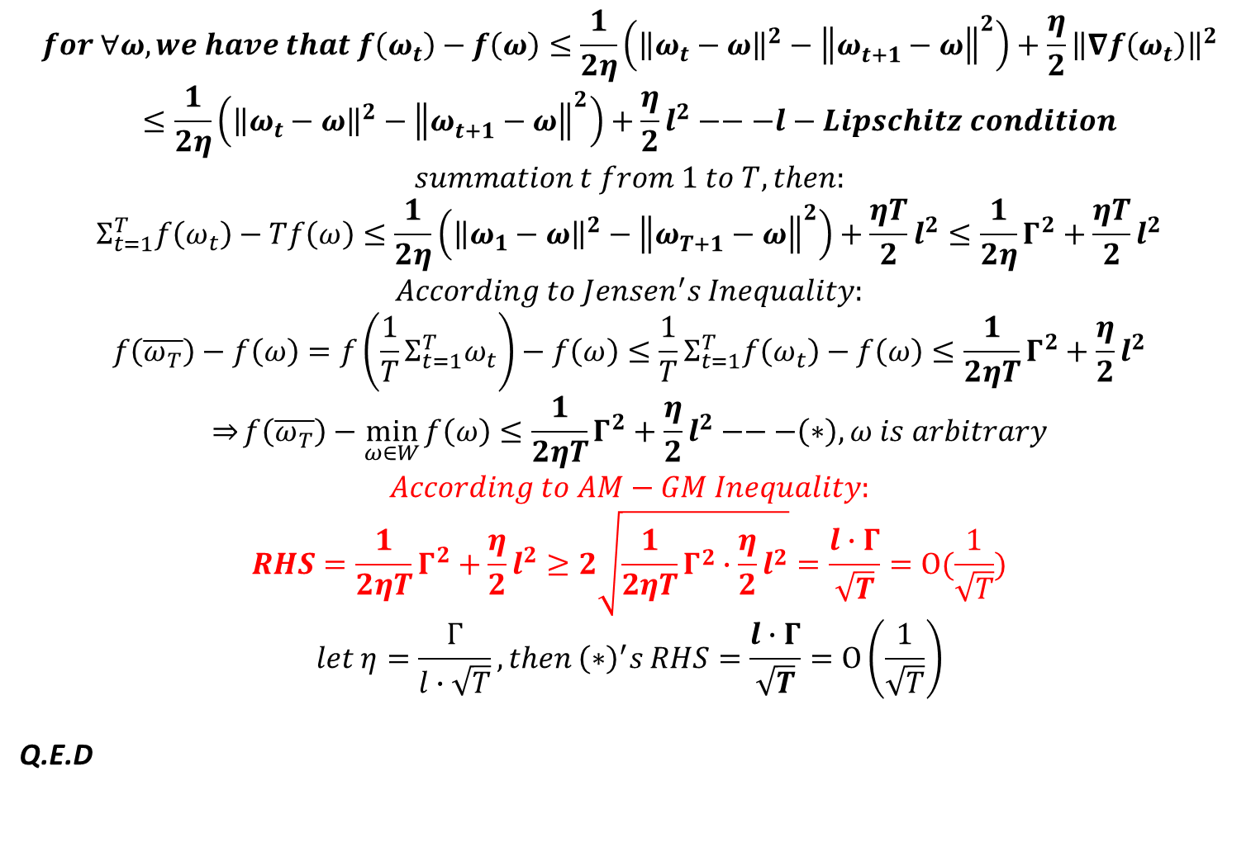
$$for ∀ω, we have that f\left(ω_{t}\right)−f\left(ω\right)≤\frac{1}{2η}\left({\left\|ω_{t}−ω\right\|}^{2}−{\left\|ω_{t+1}^{}−ω\right\|}^{2}\right)+\frac{η}{2}{\left\|∇f\left(ω_{t}\right)\right\|}^{2}$$
$$≤\frac{1}{2η}\left({\left\|ω_{t}−ω\right\|}^{2}−{\left\|ω_{t+1}^{}−ω\right\|}^{2}\right)+\frac{η}{2}l^{2}−−−l−Lipschitz condition$$
$$summation t from 1 to T, then:$$
$$Σ_{t=1}^{T}f\left(ω_{t}\right)−Tf\left(ω\right)≤\frac{1}{2η}\left({\left\|ω_{1}−ω\right\|}^{2}−{\left\|ω_{T+1}^{}−ω\right\|}^{2}\right)+\frac{ηT}{2}l^{2}≤\frac{1}{2η}Γ^{2}+\frac{ηT}{2}l^{2}$$
$$According to Jensen^{′}s Inequality:$$
$$f\left(\overline{ω_{T}}\right)−f\left(ω\right)=f\left(\frac{1}{T}Σ_{t=1}^{T}ω_{t}\right)−f\left(ω\right)≤\frac{1}{T}Σ_{t=1}^{T}f\left(ω_{t}\right)−f\left(ω\right)≤\frac{1}{2ηT}Γ^{2}+\frac{η}{2}l^{2}$$
$$\underset{⇒}{}f\left(\overline{ω_{T}}\right)−\min_{ω∈W}{f\left(ω\right)}≤\frac{1}{2ηT}Γ^{2}+\frac{η}{2}l^{2}−−−\left(∗\right),ω is arbitrary$$
$$According to AM−GM Inequality:$$
$$RHS=\frac{1}{2ηT}Γ^{2}+\frac{η}{2}l^{2}≥2\sqrt{\frac{1}{2ηT}Γ^{2}∙\frac{η}{2}l^{2}}=\frac{l∙Γ}{\sqrt{T}}=O(\frac{1}{\sqrt{T}})$$
$$let η=\frac{Γ}{l∙\sqrt{T}},then {\left(∗\right)}^{′}s RHS=\frac{l∙Γ}{\sqrt{T}}=O\left(\frac{1}{\sqrt{T}}\right)$$
Q.E.D

Slide 11
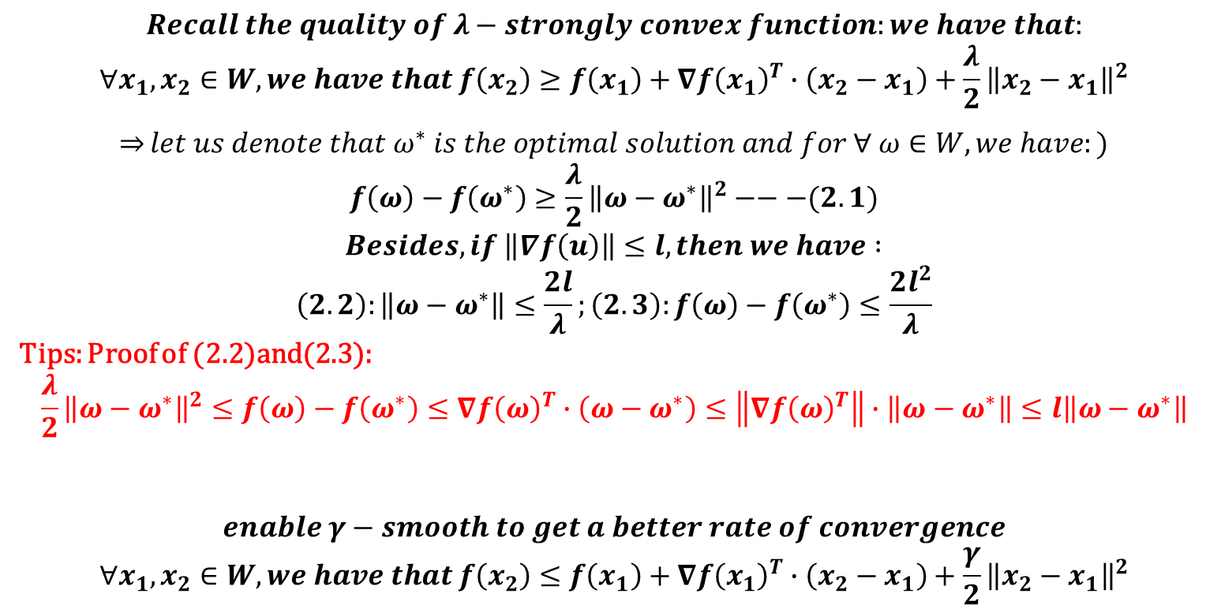
PART1@2 Deterministic Optimization for $λ−strongly$ Convex function
$$Recall the quality of λ−strongly convex function:we have that:$$
$$∀x_{1},x_{2}∈W,we have that f\left(x_{2}\right)≥f\left(x_{1}\right)+∇f{\left(x_{1}\right)}^{T}∙\left(x_{2}−x_{1}\right)+\frac{λ}{2}{\left\|x_{2}−x_{1}\right\|}^{2}$$
$$\underset{⇒}{}let us denote that ω^{∗} is the optimal solution and for ∀ ω∈W, we have:)$$
$$f\left(ω\right)−f\left(ω^{∗}\right)≥\frac{λ}{2}{\left\|ω−ω^{∗}\right\|}^{2}−−−(2.1)$$
$$Besides, if \left\|∇f\left(u\right)\right\|≤l,then we have :$$
$$\left(2.2\right):\left\|ω−ω^{∗}\right\|≤\frac{2l}{λ};\left(2.3\right):f\left(ω\right)−f\left(ω^{∗}\right)≤\frac{2l^{2}}{λ}$$
Tips: Proof of (2.2)and(2.3):
$$\frac{λ}{2}{\left\|ω−ω^{∗}\right\|}^{2}≤f\left(ω\right)−f\left(ω^{∗}\right)≤∇f{\left(ω\right)}^{T}∙\left(ω−ω^{∗}\right)≤\left\|∇f{\left(ω\right)}^{T}\right\|∙\left\|ω−ω^{∗}\right\|≤l\left\|ω−ω^{∗}\right\|$$
$$enable γ−smooth to get a better rate of convergence$$
$$∀x_{1},x_{2}∈W,we have that f\left(x_{2}\right)≤f\left(x_{1}\right)+∇f{\left(x_{1}\right)}^{T}∙\left(x_{2}−x_{1}\right)+\frac{γ}{2}{\left\|x_{2}−x_{1}\right\|}^{2}$$

Slide 12

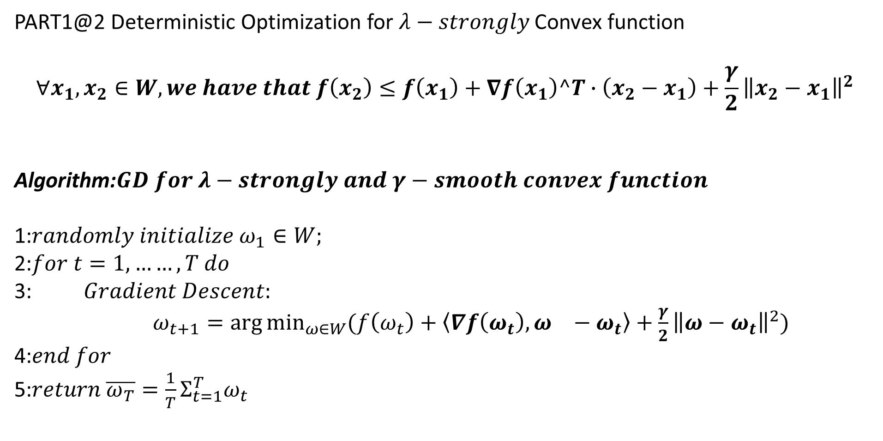
PART1@2 Deterministic Optimization for $λ−strongly$ Convex function
$$∀x_{1},x_{2}∈W,we have that f\left(x_{2}\right)≤f\left(x_{1}\right)+∇f\left(x_{1}\right)^T∙\left(x_{2}−x_{1}\right)+\frac{γ}{2}{\left\|x_{2}−x_{1}\right\|}^{2}$$
Algorithm:$GD for λ−strongly and γ−smooth convex function$
1:$randomly initialize ω_{1}∈W;$
2:$for t=1,……,T do$
3: $Gradient Descent:$
$ω_{t+1}=\arg{\min_{ω∈W}{(f\left(ω_{t}\right)+\left\langle ∇f\left(ω_{t}\right)\right.,\left.ω_{}−ω_{t}\right\rangle +\frac{γ}{2}{\left\|ω−ω_{t}\right\|}^{2})}}$
4:$end for$
5:$return \overline{ω_{T}}=\frac{1}{T}Σ_{t=1}^{T}ω_{t}$
$$ω_{t+1}=Π_{W}(ω_{t}−\frac{1}{γ}∇f(ω_{t}))$$

Slide 13
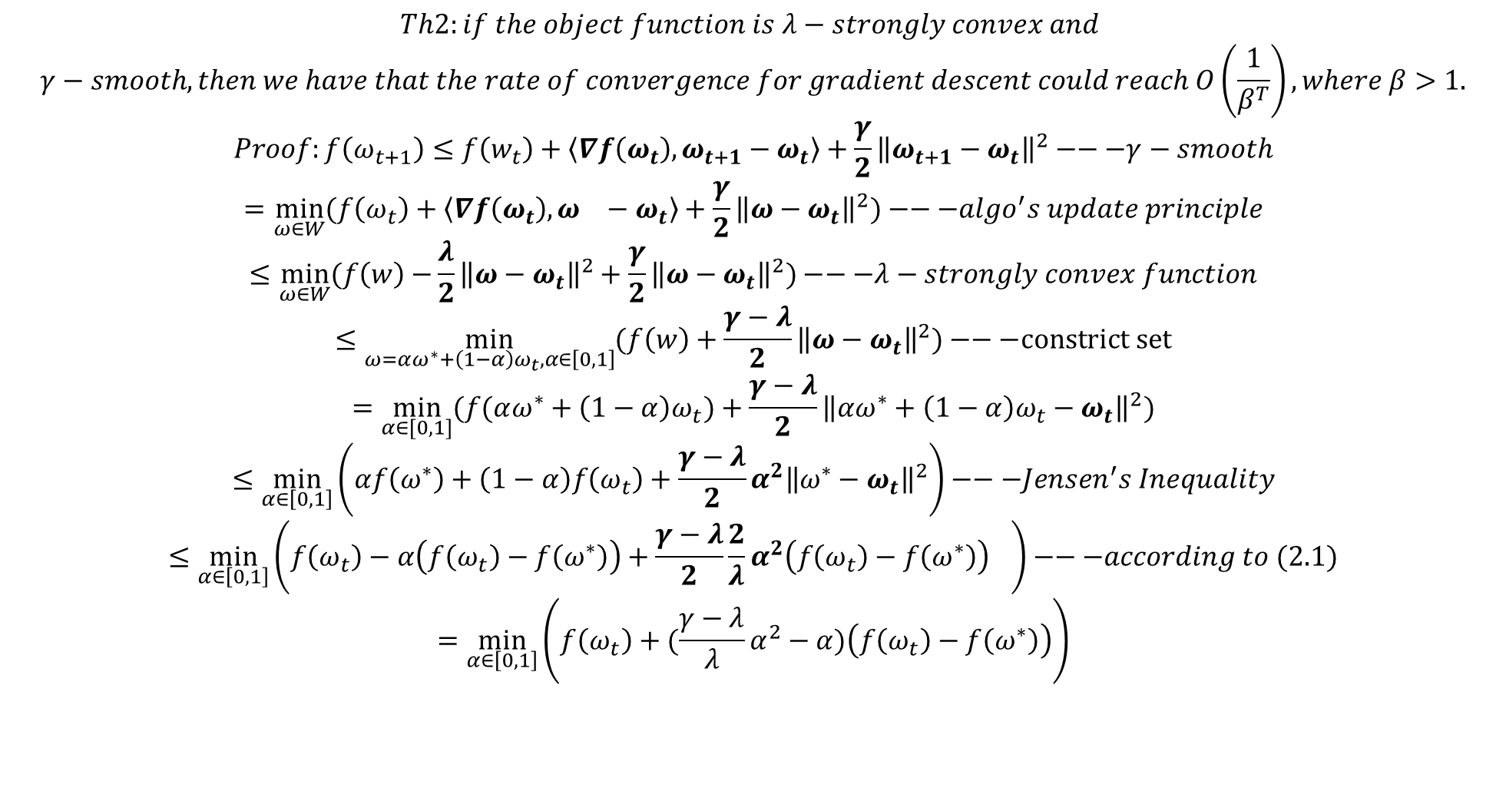
$$Th2:if the object function is λ−strongly convex and$$
$$γ−smooth, then we have that the rate of convergence for gradient descent could reach O\left(\frac{1}{β^{T}}\right),where β>1.$$
$$Proof:f\left(ω_{t+1}\right)≤f\left(w_{t}\right)+\left\langle ∇f\left(ω_{t}\right)\right.,\left.ω_{t+1}−ω_{t}\right\rangle +\frac{γ}{2}{\left\|ω_{t+1}−ω_{t}\right\|}^{2}−−−γ−smooth$$
$$=\min_{ω∈W}{(f\left(ω_{t}\right)+\left\langle ∇f\left(ω_{t}\right)\right.,\left.ω_{}−ω_{t}\right\rangle +\frac{γ}{2}{\left\|ω−ω_{t}\right\|}^{2})}−−−algo^{′}s update principle$$
$$≤\min_{ω∈W}{(f\left(w\right)−}\frac{λ}{2}{\left\|ω−ω_{t}\right\|}^{2}+\frac{γ}{2}{\left\|ω−ω_{t}\right\|}^{2})−−−λ−strongly convex function$$
$$≤\min_{ω=αω^{∗}+\left(1−α\right)ω_{t}, α∈\left[0,1\right]}{(f\left(w\right)}+\frac{γ−λ}{2}{\left\|ω−ω_{t}\right\|}^{2})−−−constrict set$$
$$=\min_{α∈[0,1]}{(f(αω^{∗}+\left(1−α\right)ω_{t})+\frac{γ−λ}{2}{\left\|αω^{∗}+\left(1−α\right)ω_{t}−ω_{t}\right\|}^{2})}$$
$$≤\min_{α∈\left[0,1\right]}\left(αf\left(ω^{∗}\right)+\left(1−α\right)f\left(ω_{t}\right)+\frac{γ−λ}{2}{α^{2}\left\|ω^{∗}−ω_{t}\right\|}^{2}\right)−−−Jensen^{′}s Inequality$$
$$≤\min_{α∈\left[0,1\right]}\left(f\left(ω_{t}\right)−α\left(f\left(ω_{t}\right)−f\left(ω^{∗}\right)\right)+\frac{γ−λ}{2}\frac{2}{λ}{α^{2}\left(f\left(ω_{t}\right)−f\left(ω^{∗}\right)\right)}^{}\right)−−−according to (2.1)$$
$$=\min_{α∈\left[0,1\right]}\left(f\left(ω_{t}\right)+(\frac{γ−λ}{λ}α^{2}−α)\left(f\left(ω_{t}\right)−f\left(ω^{∗}\right)\right)\right)$$

Slide 14
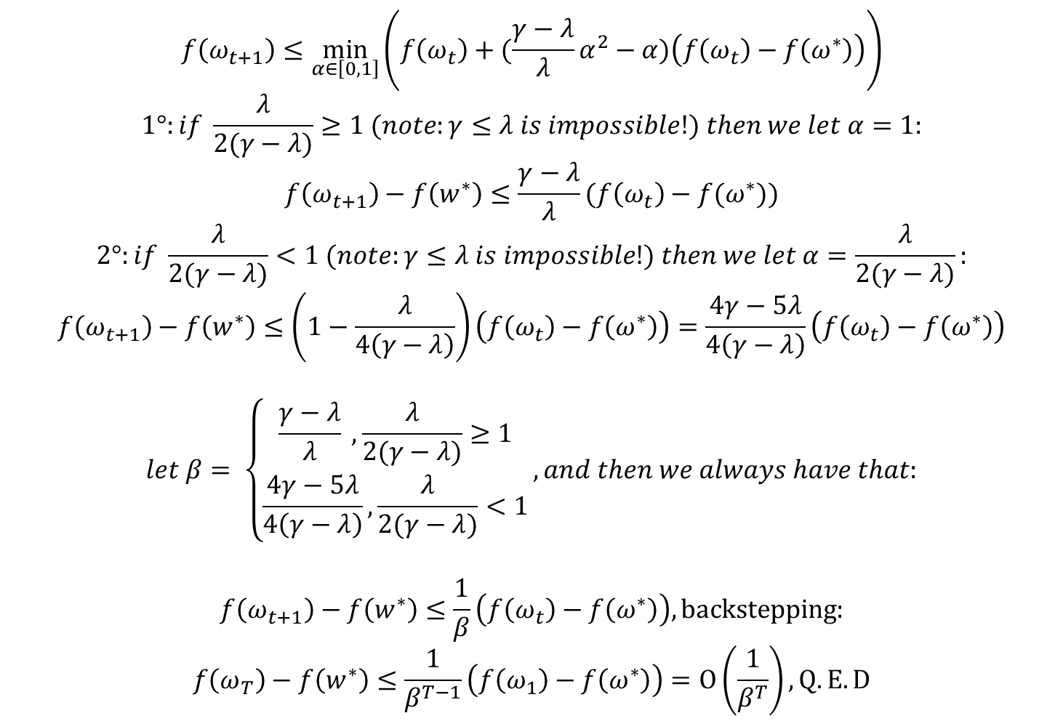
$$f\left(ω_{t+1}\right)≤\min_{α∈\left[0,1\right]}\left(f\left(ω_{t}\right)+(\frac{γ−λ}{λ}α^{2}−α)\left(f\left(ω_{t}\right)−f\left(ω^{∗}\right)\right)\right)$$
$$1°:if \frac{λ}{2(γ−λ)}≥1 (note:γ≤λ is impossible!) then we let α=1:$$
$$f\left(ω_{t+1}\right)−f\left(w^{∗}\right)≤\frac{γ−λ}{λ}(f\left(ω_{t}\right)−f(ω^{∗}))$$
$$2°:if \frac{λ}{2(γ−λ)}<1 (note:γ≤λ is impossible!) then we let α=\frac{λ}{2(γ−λ)}:$$
$$f\left(ω_{t+1}\right)−f\left(w^{∗}\right)≤\left(1−\frac{λ}{4\left(γ−λ\right)}\right)\left(f\left(ω_{t}\right)−f\left(ω^{∗}\right)\right)=\frac{4γ−5λ}{4\left(γ−λ\right)}\left(f\left(ω_{t}\right)−f\left(ω^{∗}\right)\right)$$
$$let β= \left\{\begin{aligned}\frac{γ−λ}{λ} ,\frac{λ}{2(γ−λ)}≥1 \\ \frac{4γ−5λ}{4\left(γ−λ\right)},\frac{λ}{2(γ−λ)}<1\end{aligned}\right., and then we always have that:$$
$$f\left(ω_{t+1}\right)−f\left(w^{∗}\right)≤\frac{1}{β}\left(f\left(ω_{t}\right)−f\left(ω^{∗}\right)\right),backstepping:$$
$$f\left(ω_{T}\right)−f\left(w^{∗}\right)≤\frac{1}{β^{T−1}}\left(f\left(ω_{1}\right)−f\left(ω^{∗}\right)\right)=O\left(\frac{1}{β^{T}}\right),Q.E.D$$

Slide 15
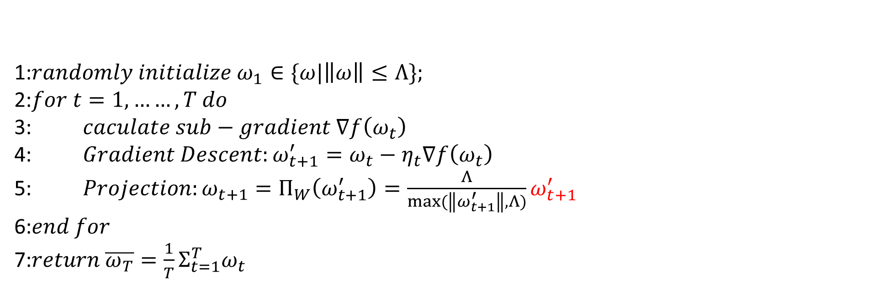

PART1@3 example analysis : SVM
$$let\left(x_{1},y_{1}\right),…,\left(x_{m},y_{m}\right)be m train samples,where x_{i}∈R^{d} and y_{i}∈\{−1,+1\}$$
$$Object function:\min_{ω}{f\left(ω\right)}=Σ_{i=1 }^{m}\max\left(0,1−y_{i}ω^{T}x_{i}\right)$$
$$Feasible Region: \left\|ω\right\|≤Λ.$$
$$Note that hinge loss is not smooth, so we are going to use sub−gradient to replace gradient:$$
$$∇f\left(ω\right)=Σ_{i=1}^{m}g_{i},where gi= \left\{\begin{aligned}−y_{i}x_{i}, 1−y_{i}ω^{T}x_{i}≥0 \\ 0, 1−y_{i}ω^{T}x_{i}<0\end{aligned}\right.$$
1:$randomly initialize ω_{1}∈\{ω|\left\|ω\right\|≤Λ\};$
2:$for t=1,……,T do$
3: $caculate sub−gradient ∇f\left(ω_{t}\right)$
4: $Gradient Descent:ω_{t+1}^{′}=ω_{t}−η_{t}∇f\left(ω_{t}\right)$
5: $Projection:ω_{t+1}=Π_{W}\left(ω_{t+1}^{′}\right)=\frac{Λ}{max⁡(\left\|ω_{t+1}^{′}\right\|,Λ)}ω_{t+1}^{′}$
6:$end for$
7:$return \overline{ω_{T}}=\frac{1}{T}Σ_{t=1}^{T}ω_{t}$

Slide 16
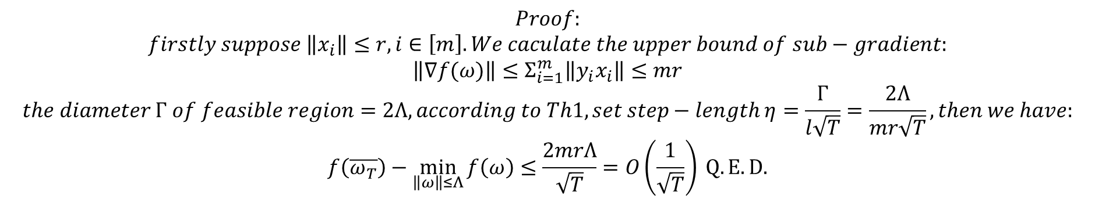
$$Proof:$$
$$firstly suppose \left\|x_{i}\right\|≤r, i∈\left[m\right]. We caculate the upper bound of sub−gradient:$$
$$\left\|∇f(ω)\right\|≤Σ_{i=1}^{m}\left\|y_{i}x_{i}\right\|≤mr$$
$$the diameter Γ of feasible region=2Λ, according to Th1, set step−length η=\frac{Γ}{l\sqrt{T}}=\frac{2Λ}{mr\sqrt{T}},then we have:$$
$$f\left(\overline{ω_{T}}\right)−\min_{\left\|ω\right\|≤Λ}{f\left(ω\right)}≤\frac{2mrΛ}{\sqrt{T}}=O\left(\frac{1}{\sqrt{T}}\right) Q.E.D.$$

Slide 17
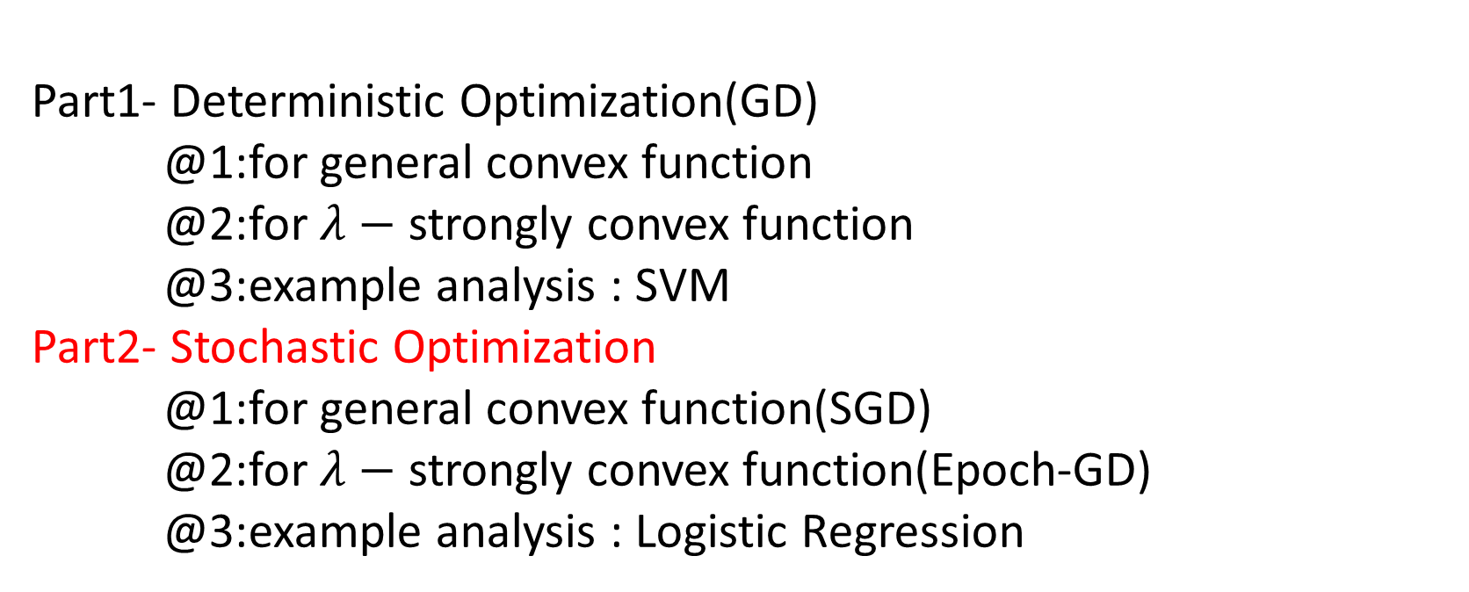
Synopsis
Part1- Deterministic Optimization(GD)
@1:for general convex function
@2:for $λ−$ strongly convex function
@3:example analysis : SVM
Part2- Stochastic Optimization
@1:for general convex function(SGD)
@2:for $λ−$ strongly convex function(Epoch-GD)
@3:example analysis : Logistic Regression

Slide 18
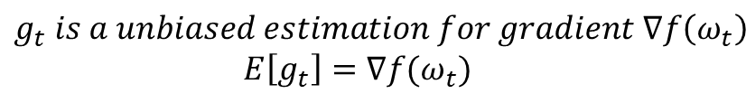


$$Obj:\min_{ω∈W}{f\left(ω\right)}=\frac{1}{m}Σ_{i=1}^{m}l\left(ω,z_{i}\right),$$
$$where m is the num of samples and z_{i}=\left(x_{i},y_{i}\right)$$
$$g_{t}= ∇l\left(ω_{t},z_{t}\right),z_{t} is randomly sample from{\left\{z_{i}\right\}}_{i=1}^{m}$$
“largely decrease computation overhead for each gradient step”
$$Unbiased Estimation:∇f\left(w_{t}\right)= ∇\left(\frac{1}{m}Σ_{i=1}^{m}l\left(ω_{t},z_{i}\right)\right)$$
$$=Σ_{i=1}^{m}∇l\left(ω_{t},z_{i}\right)∙\frac{1}{m}=E[g_{t}](conditional expectation)$$
PART2@1 Stochastic Optimization for General Convex function
Gradient Descent
1:$randomly initialize ω_{1}∈W;$
2:$for t=1,……,T do$
3: $Gradient Descent:ω_{t+1}^{′}=ω_{t}−η_{t}g_{t}$
4: $Projection:ω_{t+1}=Π_{W}\left(ω_{t+1}^{′}\right)$
5:$end for$
6:$return \overline{ω_{T}}=\frac{1}{T}Σ_{t=1}^{T}ω_{t}$
$$g_{t} is a unbiased estimation for gradient ∇f\left(ω_{t}\right)$$
$$E\left[g_{t}\right]=∇f(ω_{t})$$

Slide 19
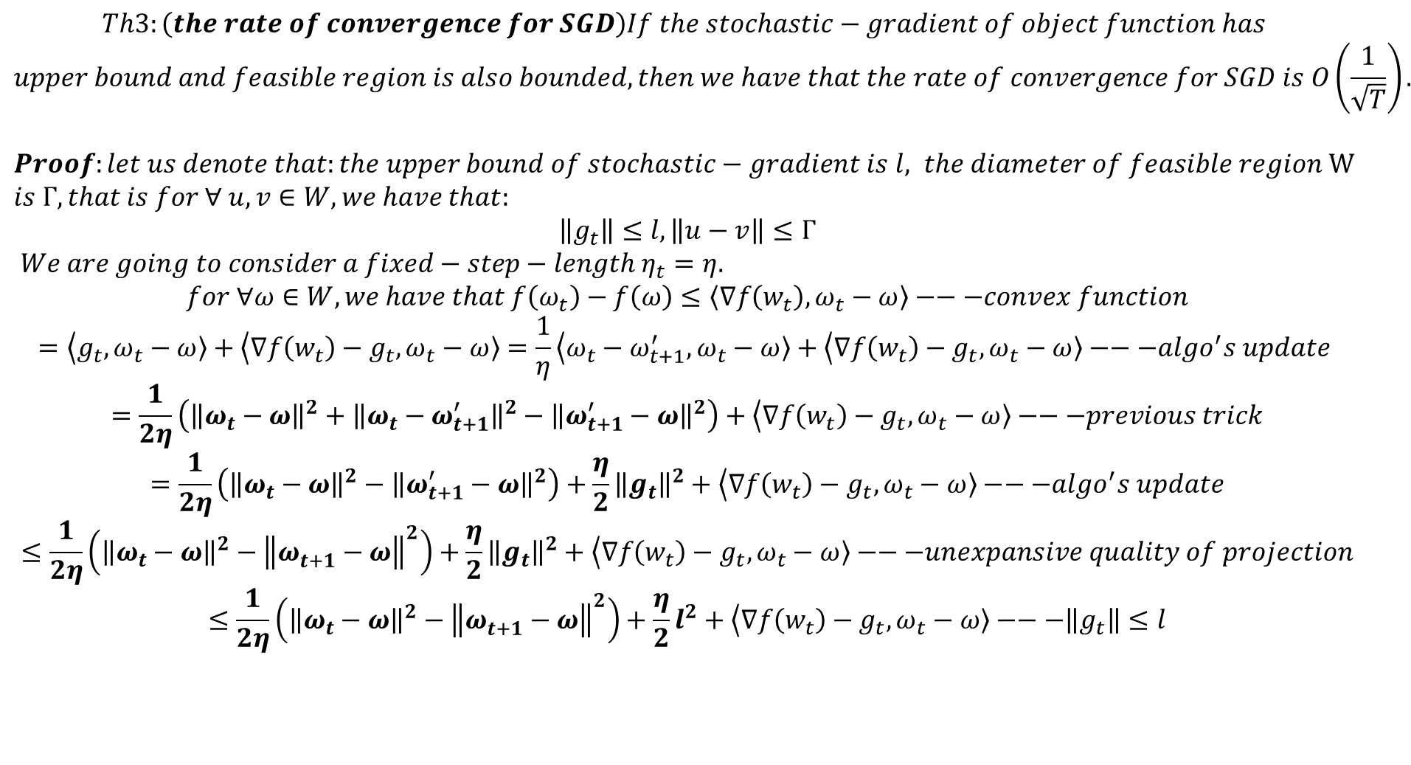
$$Th3:\left(the rate of convergence for SGD\right)If the stochastic−gradient of object function has$$
$$upper bound and feasible region is also bounded, then we have that the rate of convergence for SGD is O\left(\frac{1}{\sqrt{T}}\right).$$
$Proof:let us denote that:the upper bound of stochastic−gradient is l, the diameter of feasible region W$ $is Γ, that is for ∀ u,v∈W,we have that:$
$$\left\|g_{t}\right\|≤l, \left\|u−v\right\|≤Γ$$
$We are going to consider a fixed−step−length η_{t}=η.$
$$for ∀ω∈W,we have that f\left(ω_{t}\right)−f\left(ω\right)≤\left\langle ∇f\left(w_{t}\right)\right.,\left.ω_{t}−ω\right\rangle −−−convex function$$
$$=\left\langle g_{t}\right.,\left.ω_{t}−ω\right\rangle +\left\langle ∇f\left(w_{t}\right)−g_{t}\right.,\left.ω_{t}−ω\right\rangle =\frac{1}{η}\left\langle ω_{t}−ω_{t+1}^{′}\right.,\left.ω_{t}−ω\right\rangle +\left\langle ∇f\left(w_{t}\right)−g_{t}\right.,\left.ω_{t}−ω\right\rangle −−−algo^{′}s update$$
$$=\frac{1}{2η}\left({\left\|ω_{t}−ω\right\|}^{2}+{\left\|ω_{t}−ω_{t+1}^{′}\right\|}^{2}−{\left\|ω_{t+1}^{′}−ω\right\|}^{2}\right)+\left\langle ∇f\left(w_{t}\right)−g_{t}\right.,\left.ω_{t}−ω\right\rangle −−−previous trick$$
$$=\frac{1}{2η}\left({\left\|ω_{t}−ω\right\|}^{2}−{\left\|ω_{t+1}^{′}−ω\right\|}^{2}\right)+\frac{η}{2}{\left\|g_{t}\right\|}^{2}+\left\langle ∇f\left(w_{t}\right)−g_{t}\right.,\left.ω_{t}−ω\right\rangle −−−algo^{′}s update$$
$$≤\frac{1}{2η}\left({\left\|ω_{t}−ω\right\|}^{2}−{\left\|ω_{t+1}^{}−ω\right\|}^{2}\right)+\frac{η}{2}{\left\|g_{t}\right\|}^{2}+\left\langle ∇f\left(w_{t}\right)−g_{t}\right.,\left.ω_{t}−ω\right\rangle −−−unexpansive quality of projection$$
$$≤\frac{1}{2η}\left({\left\|ω_{t}−ω\right\|}^{2}−{\left\|ω_{t+1}^{}−ω\right\|}^{2}\right)+\frac{η}{2}l^{2}+\left\langle ∇f\left(w_{t}\right)−g_{t}\right.,\left.ω_{t}−ω\right\rangle −−−\left\|g_{t}\right\|≤l$$

Slide 20
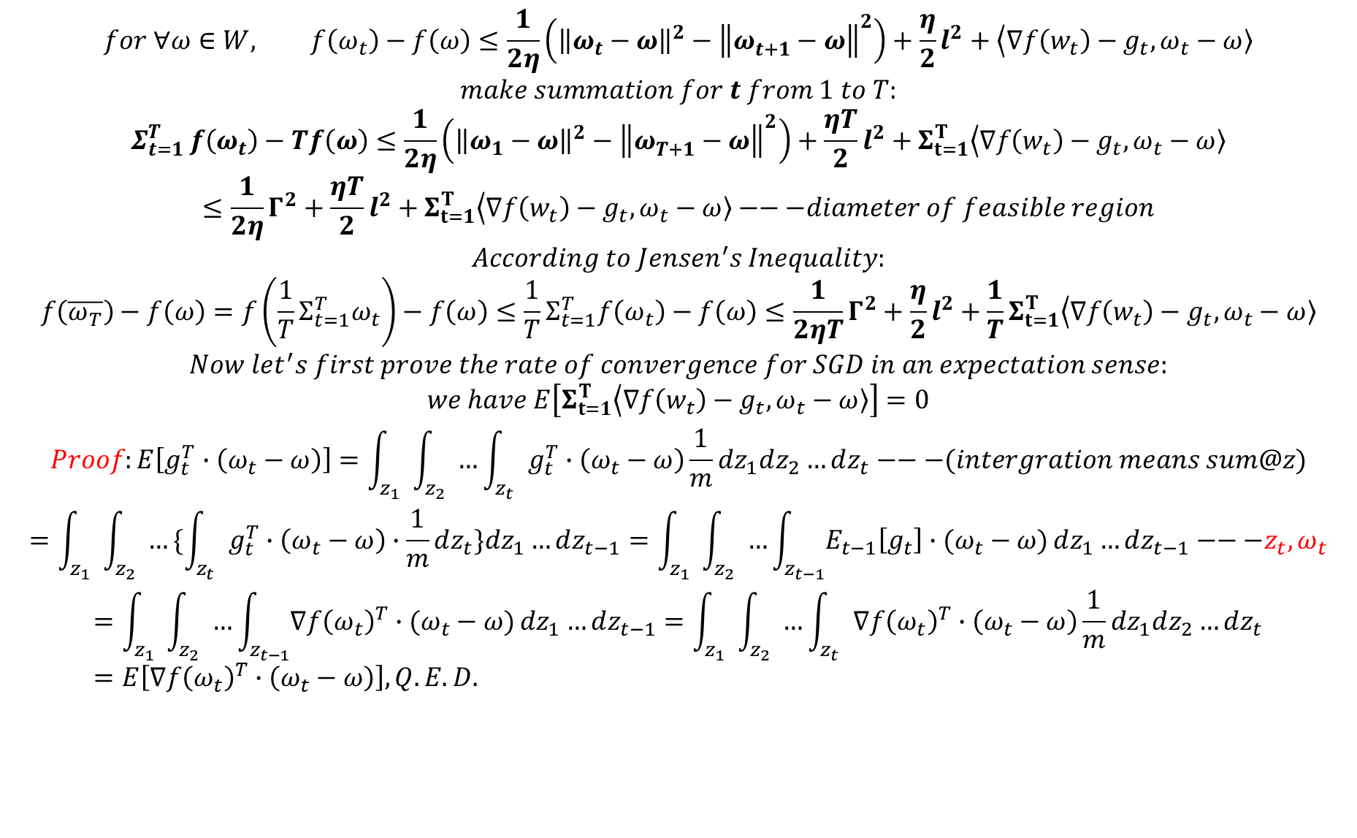
$$for ∀ω∈W, f\left(ω_{t}\right)−f\left(ω\right)≤\frac{1}{2η}\left({\left\|ω_{t}−ω\right\|}^{2}−{\left\|ω_{t+1}^{}−ω\right\|}^{2}\right)+\frac{η}{2}l^{2}+\left\langle ∇f\left(w_{t}\right)−g_{t}\right.,\left.ω_{t}−ω\right\rangle$$
$$make summation for t from 1 to T:$$
$$Σ_{t=1 }^{T}f\left(ω_{t}\right)−Tf\left(ω\right)≤\frac{1}{2η}\left({\left\|ω_{1}−ω\right\|}^{2}−{\left\|ω_{T+1}^{}−ω\right\|}^{2}\right)+\frac{ηT}{2}l^{2}+Σ_{t=1}^{T}\left\langle ∇f\left(w_{t}\right)−g_{t}\right.,\left.ω_{t}−ω\right\rangle$$
$$≤\frac{1}{2η}Γ^{2}+\frac{ηT}{2}l^{2}+Σ_{t=1}^{T}\left\langle ∇f\left(w_{t}\right)−g_{t}\right.,\left.ω_{t}−ω\right\rangle −−−diameter of feasible region$$
$$According to Jensen^{′}s Inequality:$$
$$f\left(\overline{ω_{T}}\right)−f\left(ω\right)=f\left(\frac{1}{T}Σ_{t=1}^{T}ω_{t}\right)−f\left(ω\right)≤\frac{1}{T}Σ_{t=1}^{T}f\left(ω_{t}\right)−f\left(ω\right)≤\frac{1}{2ηT}Γ^{2}+\frac{η}{2}l^{2}+\frac{1}{T}Σ_{t=1}^{T}\left\langle ∇f\left(w_{t}\right)−g_{t}\right.,\left.ω_{t}−ω\right\rangle$$
$$Now let^{′}s first prove the rate of convergence for SGD in an expectation sense:$$
$$we have E\left[Σ_{t=1}^{T}\left\langle ∇f\left(w_{t}\right)−g_{t}\right.,\left.ω_{t}−ω\right\rangle \right]=0$$
$$Proof:E\left[g_{t }^{T}∙\left(ω_{t}−ω\right)\right]=\int_{z_{1}}{\int_{z_{2}}{…\int_{z_{t}}{g_{t }^{T}∙\left(ω_{t}−ω\right)\frac{1}{m}dz_{1}dz_{2}…dz_{t}}}}−−−(intergration means sum@z)$$
$$=\int_{z_{1}}{\int_{z_{2}}{…\{\int_{z_{t}}{g_{t }^{T}∙\left(ω_{t}−ω\right)∙\frac{1}{m}dz_{t}\}dz_{1}…dz_{t−1}}}}=\int_{z_{1}}{\int_{z_{2}}{…\int_{z_{t−1}}{E_{t−1}\left[g_{t}\right]∙(ω_{t}−ω)}dz_{1}…dz_{t−1}}}−−−z_{t},ω_{t}$$
$$=\int_{z_{1}}{\int_{z_{2}}{…\int_{z_{t−1}}{∇f{\left(ω_{t}\right)}^{T}∙(ω_{t}−ω)}dz_{1}…dz_{t−1}}}=\int_{z_{1}}{\int_{z_{2}}{…\int_{z_{t}}{∇f{\left(ω_{t}\right)}^{T}∙\left(ω_{t}−ω\right)\frac{1}{m}dz_{1}dz_{2}…dz_{t}}}}=E\left[∇f{\left(ω_{t}\right)}^{T}∙\left(ω_{t}−ω\right)\right], Q.E.D.$$

Slide 21
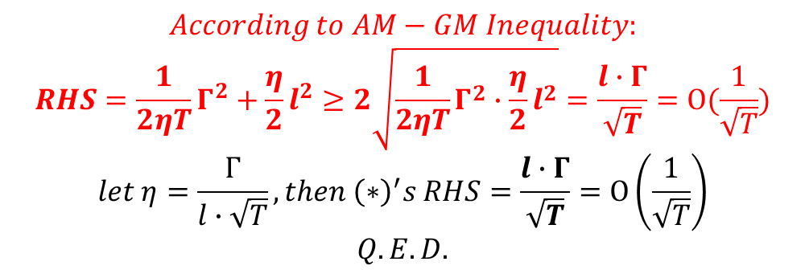

$$E\left[f\left(\overline{ω_{T}}\right)−f\left(ω\right)\right]≤E\left[\frac{1}{2ηT}Γ^{2}+\frac{η}{2}l^{2}+\frac{1}{T}Σ_{t=1}^{T}\left\langle ∇f\left(w_{t}\right)−g_{t}\right.,\left.ω_{t}−ω\right\rangle \right]$$
$$=\frac{1}{2ηT}Γ^{2}+\frac{η}{2}l^{2}$$
$$According to AM−GM Inequality:$$
$$RHS=\frac{1}{2ηT}Γ^{2}+\frac{η}{2}l^{2}≥2\sqrt{\frac{1}{2ηT}Γ^{2}∙\frac{η}{2}l^{2}}=\frac{l∙Γ}{\sqrt{T}}=O(\frac{1}{\sqrt{T}})$$
$$let η=\frac{Γ}{l∙\sqrt{T}},then {\left(∗\right)}^{′}s RHS=\frac{l∙Γ}{\sqrt{T}}=O\left(\frac{1}{\sqrt{T}}\right)$$
$$Q.E.D.$$

Slide 22

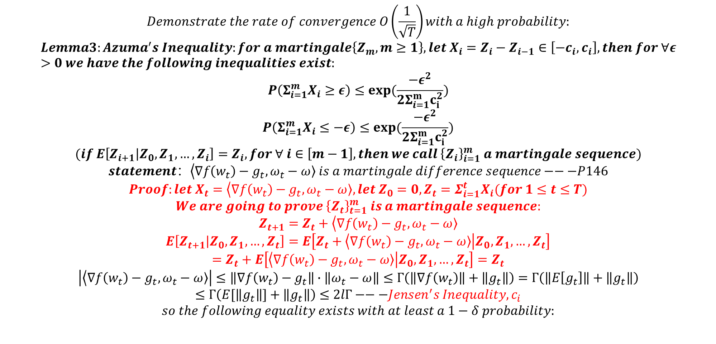
$$Demonstrate the rate of convergence O\left(\frac{1}{\sqrt{T}}\right)with a high probability:$$
$$Lemma3:Azuma^{′}s Inequality:for a martingale\left\{Z_{m},m≥1\right\}, let X_{i}=Z_{i}−Z_{i−1}∈\left[−c_{i},c_{i}\right],then for ∀ε>0 we have the following inequalities exist:$$
$$P\left(Σ_{i=1}^{m}X_{i}≥ε\right)≤exp⁡(\frac{−ε^{2}}{2Σ_{i=1}^{m}c_{i}^{2}})$$
$$P\left(Σ_{i=1}^{m}X_{i}≤−ε\right)≤exp⁡(\frac{−ε^{2}}{2Σ_{i=1}^{m}c_{i}^{2}})$$
$$(if E\left[Z_{i+1} | Z_{0},Z_{1},…,Z_{i}\right]=Z_{i}, for ∀ i∈\left[m−1\right], then we call {\left\{Z_{i}\right\}}_{i=1}^{m} a martingale sequence)$$
$$statement：\left\langle ∇f\left(w_{t}\right)−g_{t}\right.,\left.ω_{t}−ω\right\rangle is a martingale difference sequence−−−P146$$
$$Proof:let X_{t}=\left\langle ∇f\left(w_{t}\right)−g_{t}\right.,\left.ω_{t}−ω\right\rangle , let Z_{0}=0, Z_{t}=Σ_{i=1}^{t}X_{i}(for 1≤t≤T)$$
$$We are going to prove {\left\{Z_{t}\right\}}_{t=1}^{m} is a martingale sequence:$$
$$Z_{t+1}=Z_{t}+\left\langle ∇f\left(w_{t}\right)−g_{t}\right.,\left.ω_{t}−ω\right\rangle$$
$$E\left[Z_{t+1} | Z_{0},Z_{1},…,Z_{t}\right]=E\left[Z_{t}+\left\langle ∇f\left(w_{t}\right)−g_{t}\right.,\left.ω_{t}−ω\right\rangle | Z_{0},Z_{1},…,Z_{t}\right]$$
$$=Z_{t}+E\left[\left\langle ∇f\left(w_{t}\right)−g_{t}\right.,\left.ω_{t}−ω\right\rangle | Z_{0},Z_{1},…,Z_{t}\right]=Z_{t}$$
$$\left|\left\langle ∇f\left(w_{t}\right)−g_{t}\right.,\left.ω_{t}−ω\right\rangle \right|≤\left\|∇f\left(w_{t}\right)−g_{t}\right\|∙\left\|ω_{t}−ω\right\|≤Γ\left(\left\|∇f\left(w_{t}\right)\right\|+\left\|g_{t}\right\|\right)=Γ\left(\left\|E\left[g_{t}\right]\right\|+\left\|g_{t}\right\|\right)$$
$$≤Γ\left(E[\left\|g_{t}\right\|]+\left\|g_{t}\right\|\right)≤2lΓ−−−{Jensen^{′}s Inequality,c}_{i}$$
$$so the following equality exists with at least a 1−δ probability:$$
$$Σ_{t=1}^{T}\left\langle ∇f\left(w_{t}\right)−g_{t}\right.,\left.ω_{t}−ω\right\rangle ≤2lΓ\sqrt{2Tlog(\frac{1}{δ})}$$

Slide 23
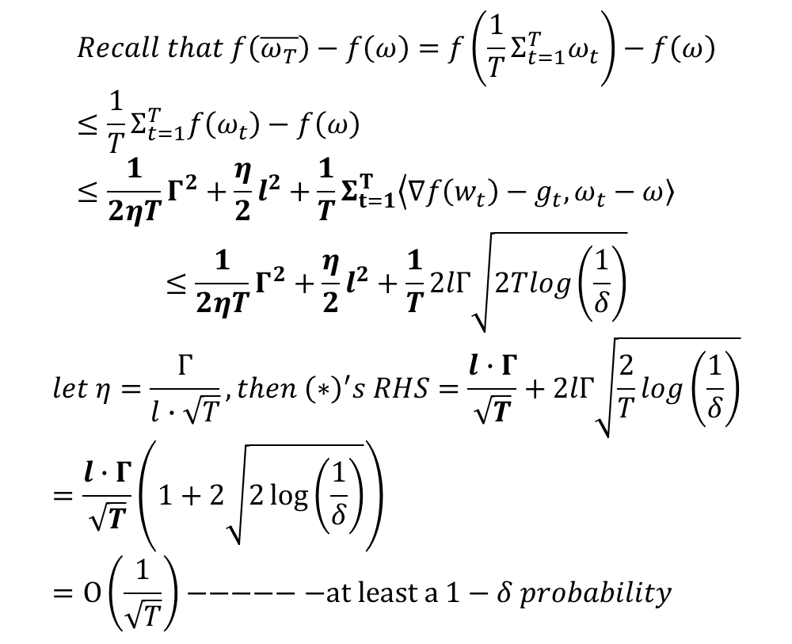
$$Recall that f\left(\overline{ω_{T}}\right)−f\left(ω\right)=f\left(\frac{1}{T}Σ_{t=1}^{T}ω_{t}\right)−f\left(ω\right)≤\frac{1}{T}Σ_{t=1}^{T}f\left(ω_{t}\right)−f\left(ω\right)≤\frac{1}{2ηT}Γ^{2}+\frac{η}{2}l^{2}+\frac{1}{T}Σ_{t=1}^{T}\left\langle ∇f\left(w_{t}\right)−g_{t}\right.,\left.ω_{t}−ω\right\rangle$$
$$≤\frac{1}{2ηT}Γ^{2}+\frac{η}{2}l^{2}+\frac{1}{T}2lΓ\sqrt{2Tlog\left(\frac{1}{δ}\right)}$$
$$let η=\frac{Γ}{l∙\sqrt{T}},then {\left(∗\right)}^{′}s RHS=\frac{l∙Γ}{\sqrt{T}}+2lΓ\sqrt{\frac{2}{T}log\left(\frac{1}{δ}\right)}=\frac{l∙Γ}{\sqrt{T}}\left(1+2\sqrt{2\log\left(\frac{1}{δ}\right)}\right)=O\left(\frac{1}{\sqrt{T}}\right)−−−−−−at least a 1−δ probability$$

Slide 24
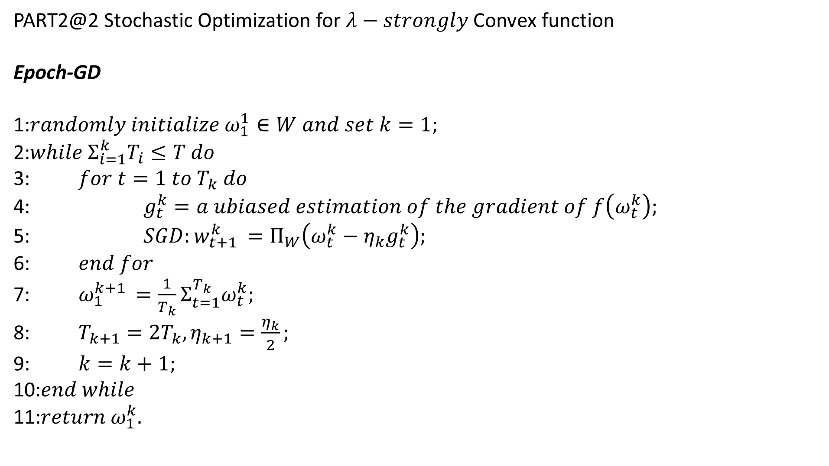
PART2@2 Stochastic Optimization for $λ−strongly$ Convex function
Epoch-GD
1:$randomly initialize ω_{1}^{1}∈W and set k=1;$
2:$while Σ_{i=1}^{k}T_{i}≤T do$
3: $for t=1 to T_{k} do$
4: $g_{t}^{k}=a ubiased estimation of the gradient of f\left(ω_{t}^{k}\right);$
5: $SGD:w_{t+1 }^{k}=Π_{W}\left(ω_{t}^{k}−η_{k}g_{t}^{k}\right);$
6: $end for$
7: $ω_{1}^{k+1 }=\frac{1}{T_{k}}Σ_{t=1}^{T_{k}}ω_{t}^{k};$
8: $T_{k+1}=2T_{k},η_{k+1}=\frac{η_{k}}{2};$
9: $k=k+1;$
10:$end while$
11:$return ω_{1}^{k}.$

Slide 25
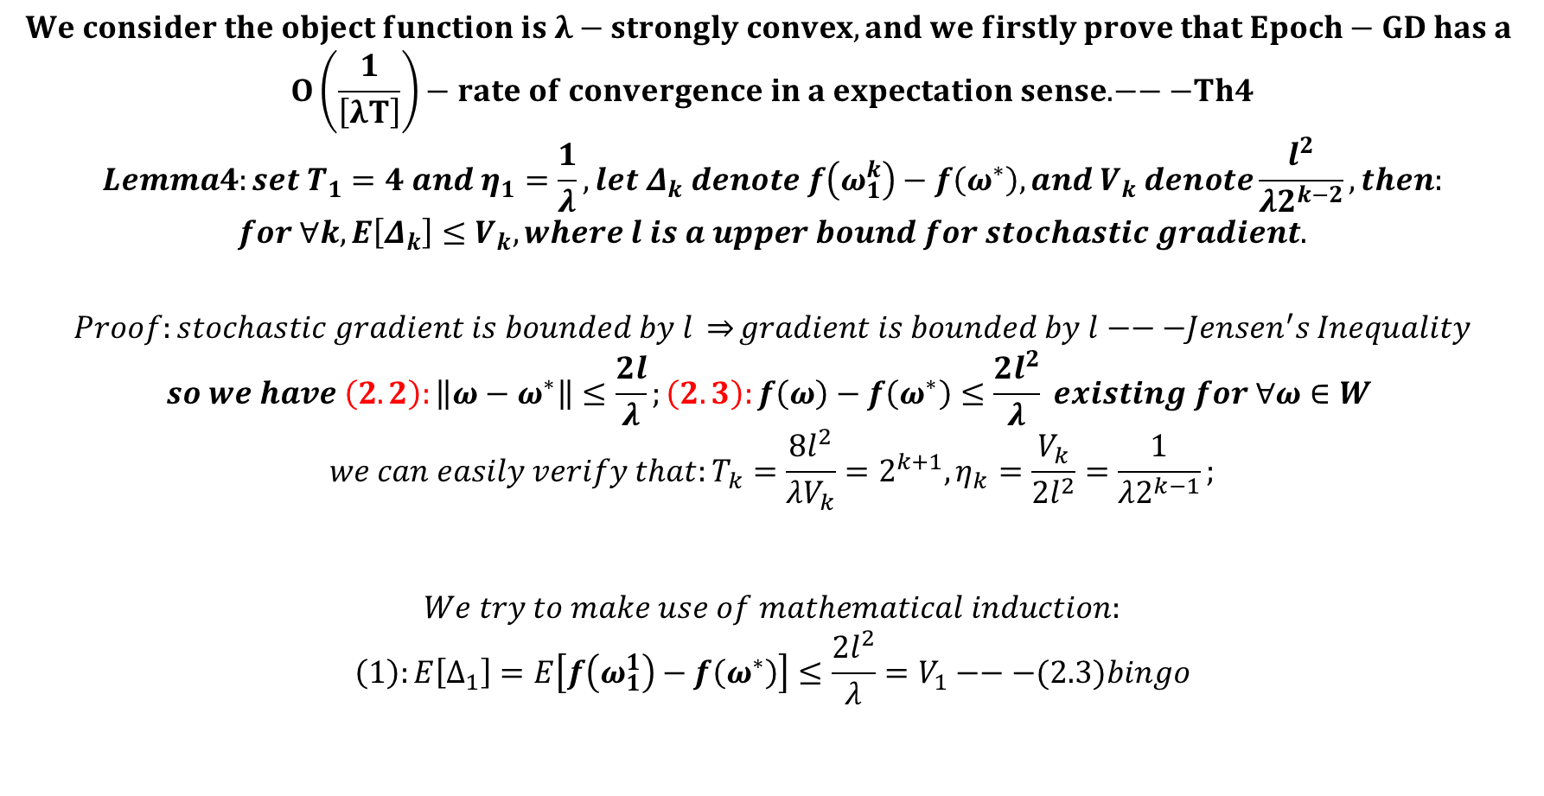
$$We consider the object function is λ−strongly convex, and we firstly prove that Epoch−GD has a$$
$$O\left(\frac{1}{\left[λT\right]}\right)−rate of convergence in a expectation sense.−−−Th4$$
$$Lemma4:set T_{1}=4 and η_{1}=\frac{1}{λ}, let Δ_{k} denote f\left(ω_{1}^{k}\right)−f\left(ω^{∗}\right),and V_{k} denote\frac{l^{2}}{λ2^{k−2}},then:$$
$$for ∀k, E\left[Δ_{k}\right]≤V_{k}, where l is a upper bound for stochastic gradient.$$
$$Proof:stochastic gradient is bounded by l \underset{⇒}{}gradient is bounded by l−−−Jensen^{′}s Inequality$$
$$so we have \left(2.2\right):\left\|ω−ω^{∗}\right\|≤\frac{2l}{λ};\left(2.3\right):f\left(ω\right)−f\left(ω^{∗}\right)≤\frac{2l^{2}}{λ} existing for ∀ω∈W$$
$$we can easily verify that:T_{k}=\frac{8l^{2}}{λV_{k}}=2^{k+1},η_{k}=\frac{V_{k}}{2l^{2}}=\frac{1}{λ2^{k−1}};$$
$$We try to make use of mathematical induction:$$
$$\left(1\right):E\left[∆_{1}\right]=E\left[f\left(ω_{1}^{1}\right)−f\left(ω^{∗}\right)\right]≤\frac{2l^{2}}{λ}=V_{1}−−−(2.3)bingo$$

Slide 26
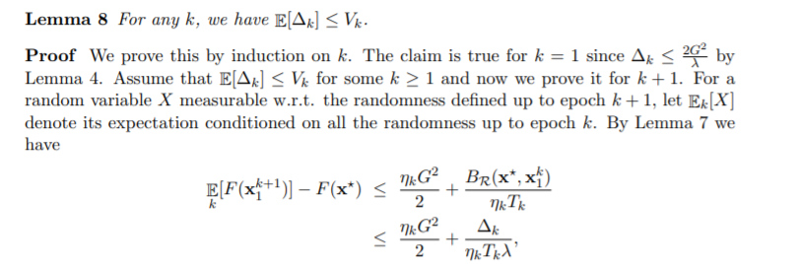

$$\left(2\right):suppose that we have already known that for a certain k≥1,E\left[Δ_{k}\right]≤\frac{l^{2}}{λ2^{k−2}}=V_{k}(∗).$$
$$for a random variable X, let the notation E_{k−1}\left[X\right] is the conditional expectation conditioned on$$
$$all the randomness up to epoch k−1.$$
JMLR2014:
$$in k th−epoch, we have that:$$
$$E_{k−1}\left[f\left(ω_{1}^{k+1}\right)\right]−f\left(ω^{∗}\right)≤\frac{η_{k}l^{2}}{2}+\frac{{\left\|ω^{∗}−ω_{1}^{k}\right\|}^{2}}{2η_{k}T_{k}}−−−similar to SGD$$
$$≤\frac{η_{k}l^{2}}{2}+\frac{Δ_{k}}{η_{k}T_{k}λ}−−−\left(2.1\right):f\left(ω\right)−f\left(ω^{∗}\right)≥\frac{λ}{2}{\left\|ω−ω^{∗}\right\|}^{2}$$
$$E\left[LHS\right]=E\left[f\left(ω_{1}^{k+1}\right)−f\left(ω^{∗}\right)\right]\left(\text{Double} \text{expectation} \text{theorem}\right)=E\left[Δ_{k+1}\right]≤\frac{η_{k}l^{2}}{2}+\frac{E\left[Δ_{k}\right]}{η_{k}T_{k}λ}≤V_{k+1}−−−\left(∗\right)and AM−GM$$

Slide 27
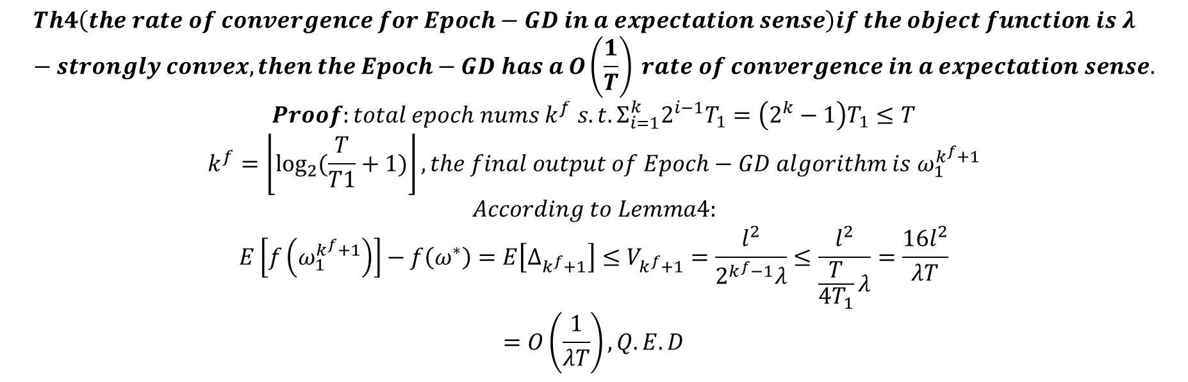
$$Th4\left(the rate of convergence for Epoch−GD in a expectation sense\right)if the object function is λ−strongly convex, then the Epoch−GD has a O\left(\frac{1}{T}\right) rate of convergence in a expectation sense.$$
$$Proof:total epoch nums k^{f} s.t. Σ_{i=1}^{k}2^{i−1}T_{1}=\left(2^{k}−1\right)T_{1}≤T$$
$$k^{f}=\left\lfloor \log_{2}{(\frac{T}{T1}+1)}\right\rfloor ,the final output of Epoch−GD algorithm is ω_{1}^{k^{f}+1}$$
$$According to Lemma4:$$
$$E\left[f\left(ω_{1}^{k^{f}+1}\right)\right]−f\left(ω^{∗}\right)=E\left[Δ_{k^{f}+1}\right]≤V_{k^{f}+1}=\frac{l^{2}}{2^{k^{f}−1}λ}≤\frac{l^{2}}{\frac{T}{4T_{1}}λ}=\frac{16l^{2}}{λT}$$
$$=O\left(\frac{1}{λT}\right),Q.E.D$$

Slide 28
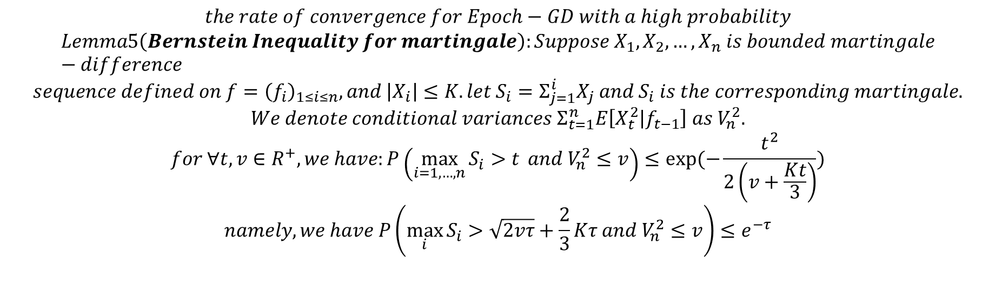
$$the rate of convergence for Epoch−GD with a high probability$$
$$Lemma5\left(Bernstein Inequality for martingale\right):Suppose X_{1},X_{2},…,X_{n} is bounded martingale−difference$$
$$sequence defined on f={\left(f_{i}\right)}_{1≤i≤n}, and \left|X_{i}\right|≤K. let S_{i}=Σ_{j=1}^{i}X_{j} and S_{i} is the corresponding martingale.$$
$$We denote conditional variances Σ_{t=1}^{n}E\left[X_{t}^{2} | f_{t−1}\right] as V_{n}^{2}.$$
$$for ∀t,v∈R^{+},we have:P\left(\max_{i=1,…,n}{S_{i}>t} and V_{n}^{2}≤v\right)≤exp⁡(−\frac{t^{2}}{2\left(v+\frac{Kt}{3}\right)})$$
$$namely, we have P\left(\max_{i}{S_{i}}>\sqrt{2vτ}+\frac{2}{3}Kτ and V_{n}^{2}≤v\right)≤e^{−τ}$$
Randomness

Slide 29
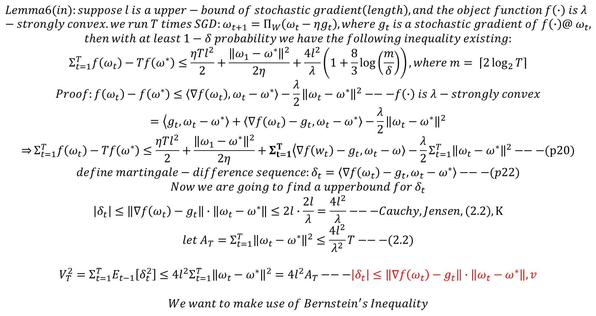
$$Lemma6(in):suppose l is a upper−bound of stochastic gradient\left(length\right), and the object function f\left(∙\right) is λ−strongly convex. we run T times SGD:ω_{t+1}=Π_{W}\left(ω_{t}−ηg_{t}\right), where g_{t} is a stochastic gradient of f\left(∙\right)@ ω_{t},$$
$$then with at least 1−δ probability we have the following inequality existing:$$
$$Σ_{t=1}^{T}f\left(ω_{t}\right)−Tf\left(ω^{∗}\right)≤\frac{ηTl^{2}}{2}+\frac{{\left\|ω_{1}−ω^{∗}\right\|}^{2}}{2η}+\frac{4l^{2}}{λ}\left(1+\frac{8}{3}\log\left(\frac{m}{δ}\right)\right),where m= \left\lceil 2\log_{2}{T}\right\rceil$$
$$Proof:f\left(ω_{t}\right)−f\left(ω^{∗}\right)≤\left\langle ∇f\left(ω_{t}\right)\right., \left.ω_{t}−ω^{∗}\right\rangle −\frac{λ}{2}{\left\|ω_{t}−ω^{∗}\right\|}^{2}−−−f\left(∙\right) is λ−strongly convex$$
$$=\left\langle g_{t}\right.,\left.ω_{t}−ω^{∗}\right\rangle +\left\langle ∇f(ω_{t})\right.−g_{t},\left.ω_{t}−ω^{∗}\right\rangle −\frac{λ}{2}{\left\|ω_{t}−ω^{∗}\right\|}^{2}$$
$$\underset{⇒}{}Σ_{t=1}^{T}f\left(ω_{t}\right)−Tf\left(ω^{∗}\right)≤\frac{ηTl^{2}}{2}+\frac{{\left\|ω_{1}−ω^{∗}\right\|}^{2}}{2η}+Σ_{t=1}^{T}\left\langle ∇f\left(w_{t}\right)−g_{t}\right.,\left.ω_{t}−ω\right\rangle −\frac{λ}{2}Σ_{t=1}^{T}{\left\|ω_{t}−ω^{∗}\right\|}^{2}−−−(p20)$$
$$define martingale−difference sequence:δ_{t}=\left\langle ∇f\left(ω_{t}\right)\right.−g_{t},\left.ω_{t}−ω^{∗}\right\rangle −−−(p22)$$
$$Now we are going to find a upperbound for δ_{t}$$
$$\left|δ_{t}\right|≤\left\|∇f\left(ω_{t}\right)−g_{t}\right\|∙\left\|ω_{t}−ω^{∗}\right\|≤2l∙\frac{2l}{λ}=\frac{4l^{2}}{λ}−−−Cauchy,Jensen,\left(2.2\right),K$$
$$let A_{T}=Σ_{t=1}^{T}{\left\|ω_{t}−ω^{∗}\right\|}^{2}≤\frac{4l^{2}}{λ^{2}}T−−−(2.2)$$
$$V_{T}^{2}=Σ_{t=1}^{T}E_{t−1}\left[δ_{t}^{2}\right]≤4l^{2}Σ_{t=1}^{T}{\left\|ω_{t}−ω^{∗}\right\|}^{2}=4l^{2}A_{T}−−−\left|δ_{t}\right|≤\left\|∇f\left(ω_{t}\right)−g_{t}\right\|∙\left\|ω_{t}−ω^{∗}\right\|,v$$
$$We want to make use of Bernstein^{′}s Inequality$$

Slide 30
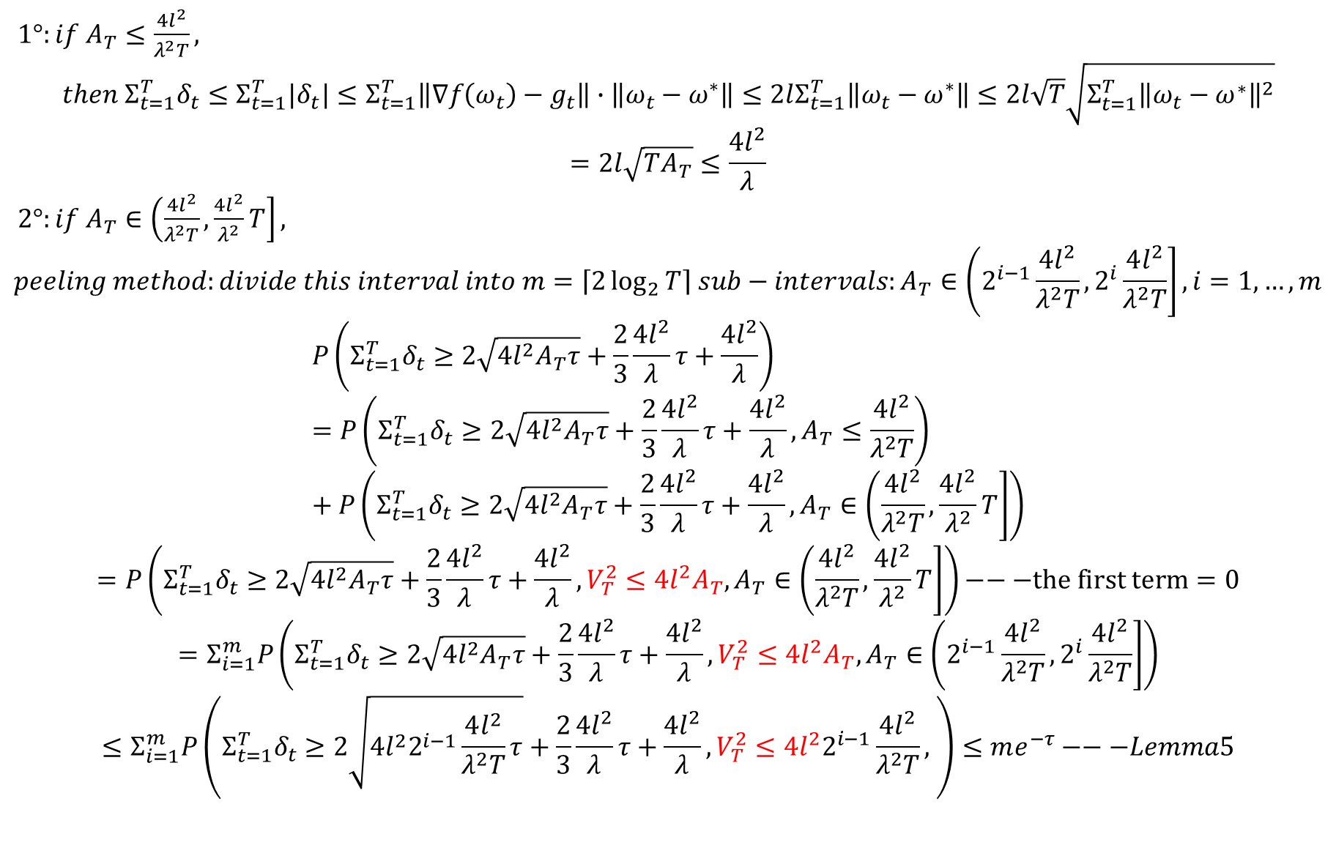
$1°:if A_{T}≤\frac{4l^{2}}{λ^{2}T},$
$$then Σ_{t=1}^{T}δ_{t}≤Σ_{t=1}^{T}{|δ}_{t}|≤Σ_{t=1}^{T}\left\|∇f\left(ω_{t}\right)−g_{t}\right\|∙\left\|ω_{t}−ω^{∗}\right\|≤2lΣ_{t=1}^{T}\left\|ω_{t}−ω^{∗}\right\|≤2l\sqrt{T}\sqrt{Σ_{t=1}^{T}{\left\|ω_{t}−ω^{∗}\right\|}^{2}}$$
$$=2l\sqrt{TA_{T}}≤\frac{4l^{2}}{λ}$$
$2°:if A_{T}∈\left(\frac{4l^{2}}{λ^{2}T},\frac{4l^{2}}{λ^{2}}T\right],$
$$peeling method:divide this interval into m=\left\lceil 2\log_{2}{T}\right\rceil sub−intervals:A_{T}∈\left(2^{i−1}\frac{4l^{2}}{λ^{2}T},2^{i}\frac{4l^{2}}{λ^{2}T}\right],i=1,…,m$$
$$P\left(Σ_{t=1}^{T}δ_{t}≥2\sqrt{4l^{2}A_{T}τ}+\frac{2}{3}\frac{4l^{2}}{λ}τ+\frac{4l^{2}}{λ}\right)=P\left(Σ_{t=1}^{T}δ_{t}≥2\sqrt{4l^{2}A_{T}τ}+\frac{2}{3}\frac{4l^{2}}{λ}τ+\frac{4l^{2}}{λ},A_{T}≤\frac{4l^{2}}{λ^{2}T}\right)+P\left(Σ_{t=1}^{T}δ_{t}≥2\sqrt{4l^{2}A_{T}τ}+\frac{2}{3}\frac{4l^{2}}{λ}τ+\frac{4l^{2}}{λ},A_{T}∈\left(\frac{4l^{2}}{λ^{2}T},\frac{4l^{2}}{λ^{2}}T\right]\right)$$
$$=P\left(Σ_{t=1}^{T}δ_{t}≥2\sqrt{4l^{2}A_{T}τ}+\frac{2}{3}\frac{4l^{2}}{λ}τ+\frac{4l^{2}}{λ},V_{T}^{2}≤4l^{2}A_{T},A_{T}∈\left(\frac{4l^{2}}{λ^{2}T},\frac{4l^{2}}{λ^{2}}T\right]\right)−−−the first term=0$$
$$=Σ_{i=1}^{m}P\left(Σ_{t=1}^{T}δ_{t}≥2\sqrt{4l^{2}A_{T}τ}+\frac{2}{3}\frac{4l^{2}}{λ}τ+\frac{4l^{2}}{λ},V_{T}^{2}≤4l^{2}A_{T},A_{T}∈\left(2^{i−1}\frac{4l^{2}}{λ^{2}T},2^{i}\frac{4l^{2}}{λ^{2}T}\right]\right)$$
$$≤Σ_{i=1}^{m}P\left(Σ_{t=1}^{T}δ_{t}≥2\sqrt{4l^{2}2^{i−1}\frac{4l^{2}}{λ^{2}T}τ}+\frac{2}{3}\frac{4l^{2}}{λ}τ+\frac{4l^{2}}{λ},V_{T}^{2}≤4l^{2}2^{i−1}\frac{4l^{2}}{λ^{2}T}, \right)≤me^{−τ}−−−Lemma5$$

Slide 31
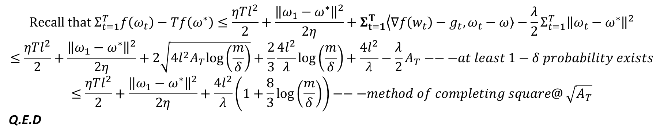
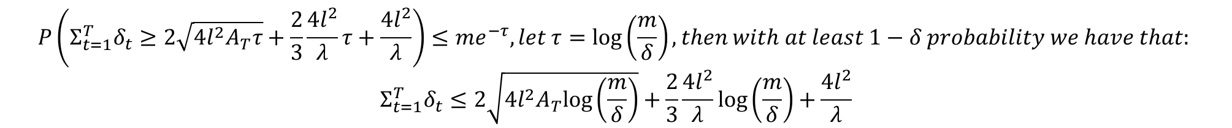
$$P\left(Σ_{t=1}^{T}δ_{t}≥2\sqrt{4l^{2}A_{T}τ}+\frac{2}{3}\frac{4l^{2}}{λ}τ+\frac{4l^{2}}{λ}\right)≤me^{−τ},let τ=log\left(\frac{m}{δ}\right),then with at least 1−δ probability we have that:⁡$$
$$Σ_{t=1}^{T}δ_{t}≤2\sqrt{4l^{2}A_{T}log\left(\frac{m}{δ}\right)}+\frac{2}{3}\frac{4l^{2}}{λ}log\left(\frac{m}{δ}\right)+\frac{4l^{2}}{λ}$$
$${Recall that Σ}_{t=1}^{T}f\left(ω_{t}\right)−Tf\left(ω^{∗}\right)≤\frac{ηTl^{2}}{2}+\frac{{\left\|ω_{1}−ω^{∗}\right\|}^{2}}{2η}+Σ_{t=1}^{T}\left\langle ∇f\left(w_{t}\right)−g_{t}\right.,\left.ω_{t}−ω\right\rangle −\frac{λ}{2}Σ_{t=1}^{T}{\left\|ω_{t}−ω^{∗}\right\|}^{2}$$
$$≤\frac{ηTl^{2}}{2}+\frac{{\left\|ω_{1}−ω^{∗}\right\|}^{2}}{2η}+2\sqrt{4l^{2}A_{T}log\left(\frac{m}{δ}\right)}+\frac{2}{3}\frac{4l^{2}}{λ}log\left(\frac{m}{δ}\right)+\frac{4l^{2}}{λ}−\frac{λ}{2}A_{T}−−−at least 1−δ probability exists$$
$$≤\frac{ηTl^{2}}{2}+\frac{{\left\|ω_{1}−ω^{∗}\right\|}^{2}}{2η}+\frac{4l^{2}}{λ}\left(1+\frac{8}{3}\log\left(\frac{m}{δ}\right)\right)−−−method of completing square@ \sqrt{A_{T}}$$
Q.E.D

Slide 32
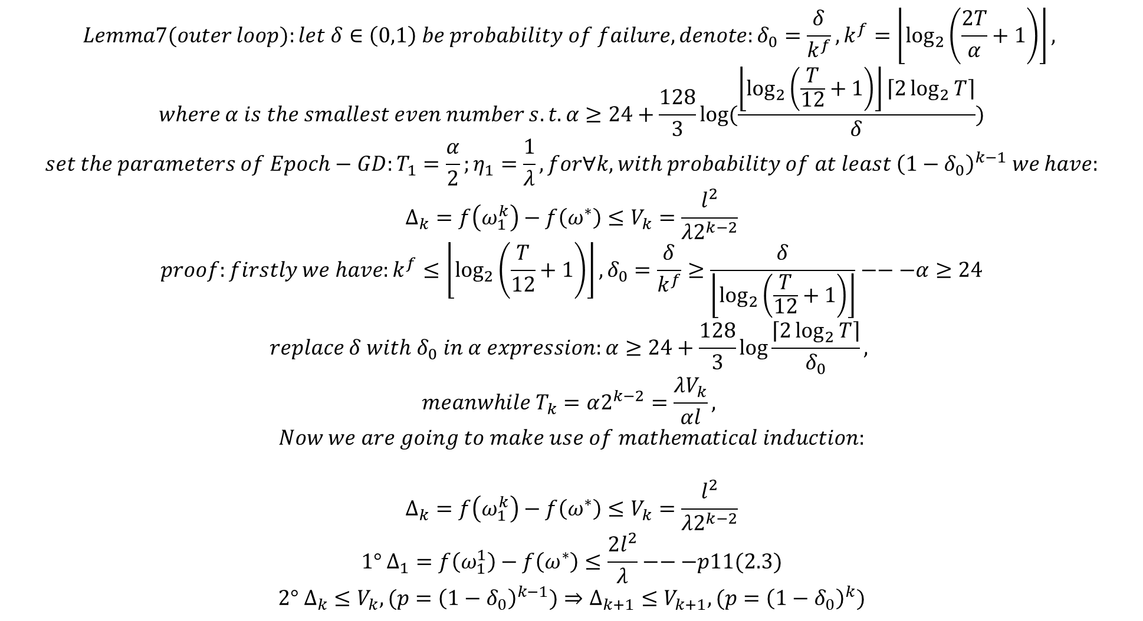
$$Lemma7(outer loop):let δ∈\left(0,1\right) be probability of failure, denote:δ_{0}=\frac{δ}{k^{f}},k^{f}=\left\lfloor \log_{2}\left(\frac{2T}{α}+1\right)\right\rfloor ,$$
$$where α is the smallest even number s.t. α≥24+\frac{128}{3}\log{(\frac{\left\lfloor \log_{2}\left(\frac{T}{12}+1\right)\right\rfloor \left\lceil 2\log_{2}{T}\right\rceil }{δ})}$$
$$set the parameters of Epoch−GD:T_{1}=\frac{α}{2};η_{1}=\frac{1}{λ},for∀k,with probability of at least {\left(1−δ_{0}\right)}^{k−1} we have:$$
$$Δ_{k}=f\left(ω_{1}^{k}\right)−f\left(ω^{∗}\right)≤V_{k}=\frac{l^{2}}{λ2^{k−2}}$$
$$proof:firstly we have:k^{f}≤\left\lfloor \log_{2}\left(\frac{T}{12}+1\right)\right\rfloor ,δ_{0}=\frac{δ}{k^{f}}≥\frac{δ}{\left\lfloor \log_{2}\left(\frac{T}{12}+1\right)\right\rfloor }−−−α≥24$$
$$replace δ with δ_{0} in α expression:α≥24+\frac{128}{3}\log{\frac{\left\lceil 2\log_{2}{T}\right\rceil }{δ_{0}}},$$
$$meanwhile T_{k}=α2^{k−2}=\frac{λV_{k}}{αl},$$
$$Now we are going to make use of mathematical induction:$$
$$Δ_{k}=f\left(ω_{1}^{k}\right)−f\left(ω^{∗}\right)≤V_{k}=\frac{l^{2}}{λ2^{k−2}}$$
$$1° Δ_{1}=f\left(ω_{1}^{1}\right)−f\left(ω^{∗}\right)≤\frac{{2l}^{2}}{λ}−−−p11(2.3)$$
$$2° Δ_{k}≤V_{k},(p={\left(1−δ_{0}\right)}^{k−1})⇒Δ_{k+1}≤V_{k+1},(p={\left(1−δ_{0}\right)}^{k})$$

Slide 33
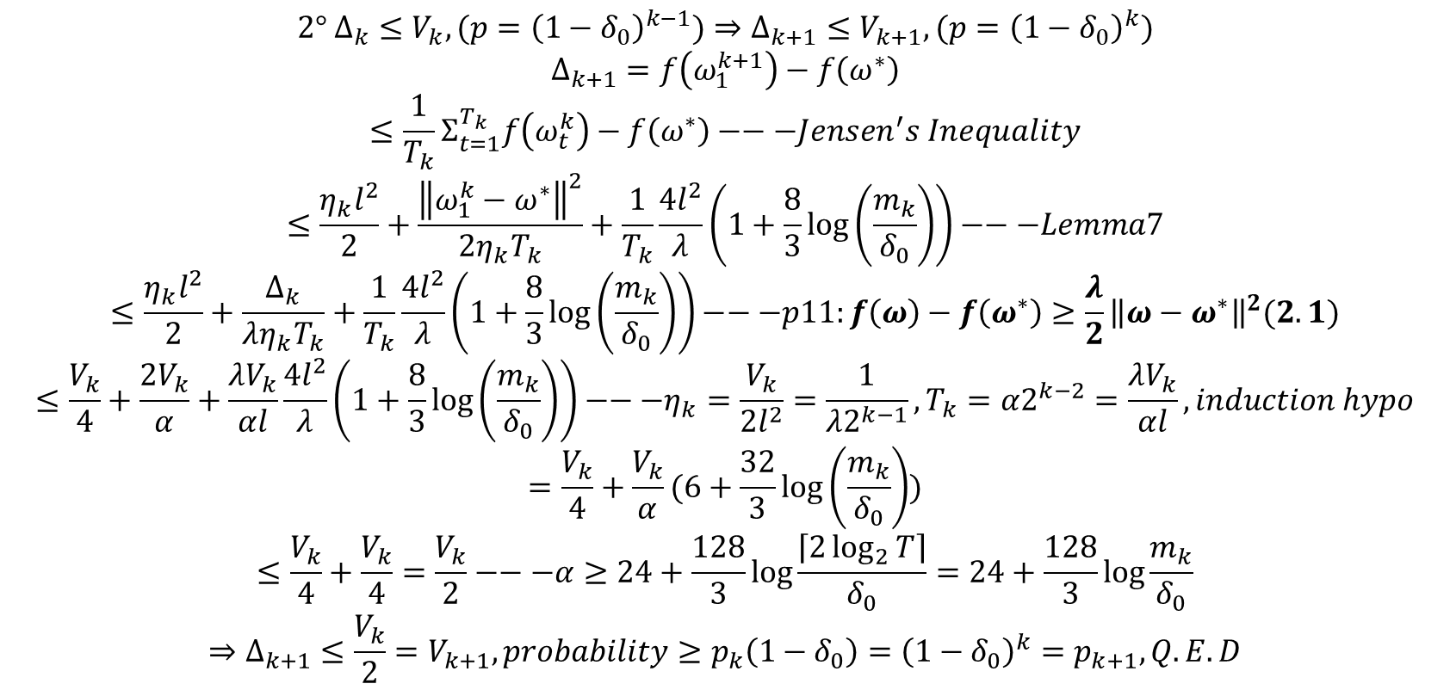
$$2° Δ_{k}≤V_{k},(p={\left(1−δ_{0}\right)}^{k−1})⇒Δ_{k+1}≤V_{k+1},(p={\left(1−δ_{0}\right)}^{k})$$
$$Δ_{k+1}=f\left(ω_{1}^{k+1}\right)−f\left(ω^{∗}\right)$$
$$≤\frac{1}{T_{k}}Σ_{t=1}^{T_{k}}f\left(ω_{t}^{k}\right)−f\left(ω^{∗}\right)−−−Jensen^{′}s Inequality$$
$$≤\frac{η_{k}l^{2}}{2}+\frac{{\left\|ω_{1}^{k}−ω^{∗}\right\|}^{2}}{2η_{k}T_{k}}+\frac{1}{T_{k}}\frac{4l^{2}}{λ}\left(1+\frac{8}{3}\log\left(\frac{m_{k}}{δ_{0}}\right)\right)−−−Lemma7$$
$$≤\frac{η_{k}l^{2}}{2}+\frac{Δ_{k}}{λη_{k}T_{k}}+\frac{1}{T_{k}}\frac{4l^{2}}{λ}\left(1+\frac{8}{3}\log\left(\frac{m_{k}}{δ_{0}}\right)\right)−−−p11:f\left(ω\right)−f\left(ω^{∗}\right)≥\frac{λ}{2}{\left\|ω−ω^{∗}\right\|}^{2}(2.1)$$
$$≤\frac{V_{k}}{4}+\frac{2V_{k}}{α}+\frac{λV_{k}}{αl}\frac{4l^{2}}{λ}\left(1+\frac{8}{3}\log\left(\frac{m_{k}}{δ_{0}}\right)\right)−−−η_{k}=\frac{V_{k}}{2l^{2}}=\frac{1}{λ2^{k−1}},T_{k}=α2^{k−2}=\frac{λV_{k}}{αl},induction hypo$$
$$=\frac{V_{k}}{4}+\frac{V_{k}}{α}(6+\frac{32}{3}\log\left(\frac{m_{k}}{δ_{0}}\right))$$
$$≤\frac{V_{k}}{4}+\frac{V_{k}}{4}=\frac{V_{k}}{2}−−−α≥24+\frac{128}{3}\log{\frac{\left\lceil 2\log_{2}{T}\right\rceil }{δ_{0}}}=24+\frac{128}{3}\log{\frac{m_{k}}{δ_{0}}}$$
$$⇒Δ_{k+1}≤\frac{V_{k}}{2}=V_{k+1}, probability≥p_{k}\left(1−δ_{0}\right)={\left(1−δ_{0}\right)}^{k}=p_{k+1},Q.E.D$$

Slide 34
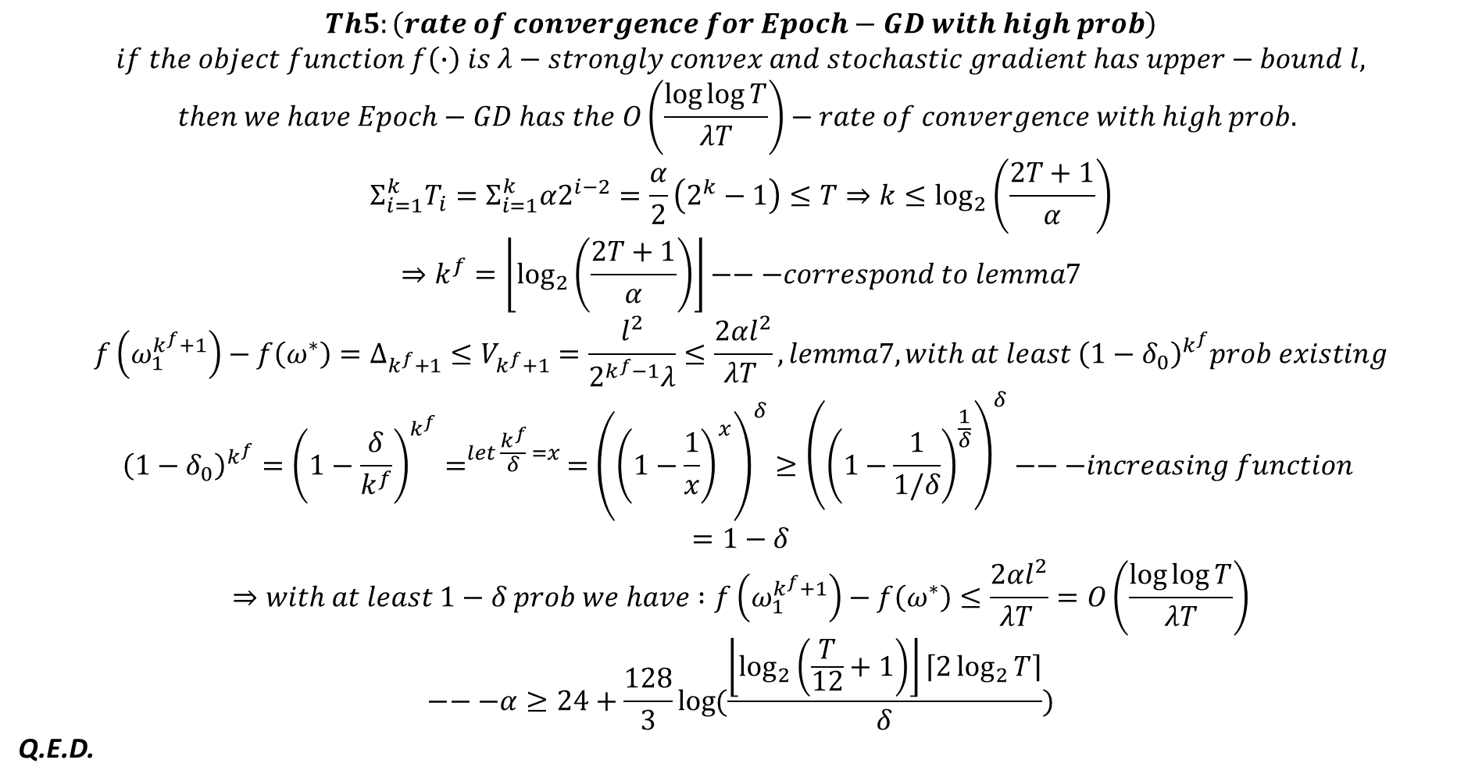
$$Th5:\left(rate of convergence for Epoch−GD with high prob\right)$$
$$if the object function f\left(∙\right) is λ−strongly convex and stochastic gradient has upper−bound l,$$
$$then we have Epoch−GD has the O\left(\frac{\log{\log{T}}}{λT}\right)−rate of convergence with high prob.$$
$$Σ_{i=1}^{k}T_{i}=Σ_{i=1}^{k}α2^{i−2}=\frac{α}{2}\left(2^{k}−1\right)≤T⇒k≤\log_{2}\left(\frac{2T+1}{α}\right)$$
$$⇒k^{f}=\left\lfloor \log_{2}\left(\frac{2T+1}{α}\right)\right\rfloor −−−correspond to lemma7$$
$$f\left(ω_{1}^{k^{f}+1}\right)−f\left(ω^{∗}\right)=Δ_{k^{f}+1}≤V_{k^{f}+1}=\frac{l^{2}}{2^{k^{f}−1}λ}≤\frac{2αl^{2}}{λT }, lemma7, with at least {\left(1−δ_{0}\right)}^{k^{f}}prob existing$$
$${\left(1−δ_{0}\right)}^{k^{f}}={\left(1−\frac{δ}{k^{f}}\right)}^{k^{f}}=^{let \frac{k^{f}}{δ} =x }={\left({\left(1−\frac{1}{x}\right)}^{x}\right)}^{δ}≥{\left({\left(1−\frac{1}{1/δ}\right)}^{\frac{1}{δ}}\right)}^{δ}−−−increasing function$$
$$=1−δ$$
$$⇒with at least 1−δ prob we have :f\left(ω_{1}^{k^{f}+1}\right)−f\left(ω^{∗}\right)≤\frac{2αl^{2}}{λT }=O\left(\frac{\log{\log{T}}}{λT}\right)$$
$$−−−α≥24+\frac{128}{3}\log{(\frac{\left\lfloor \log_{2}\left(\frac{T}{12}+1\right)\right\rfloor \left\lceil 2\log_{2}{T}\right\rceil }{δ})}$$
Q.E.D.

Slide 35
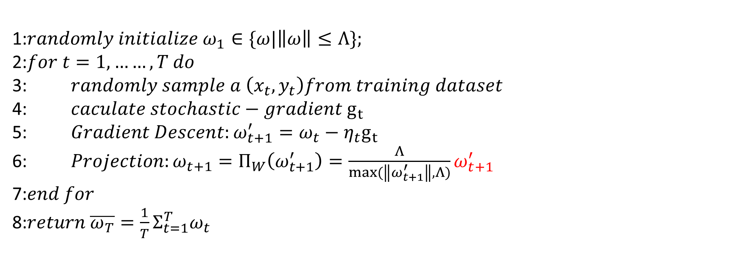
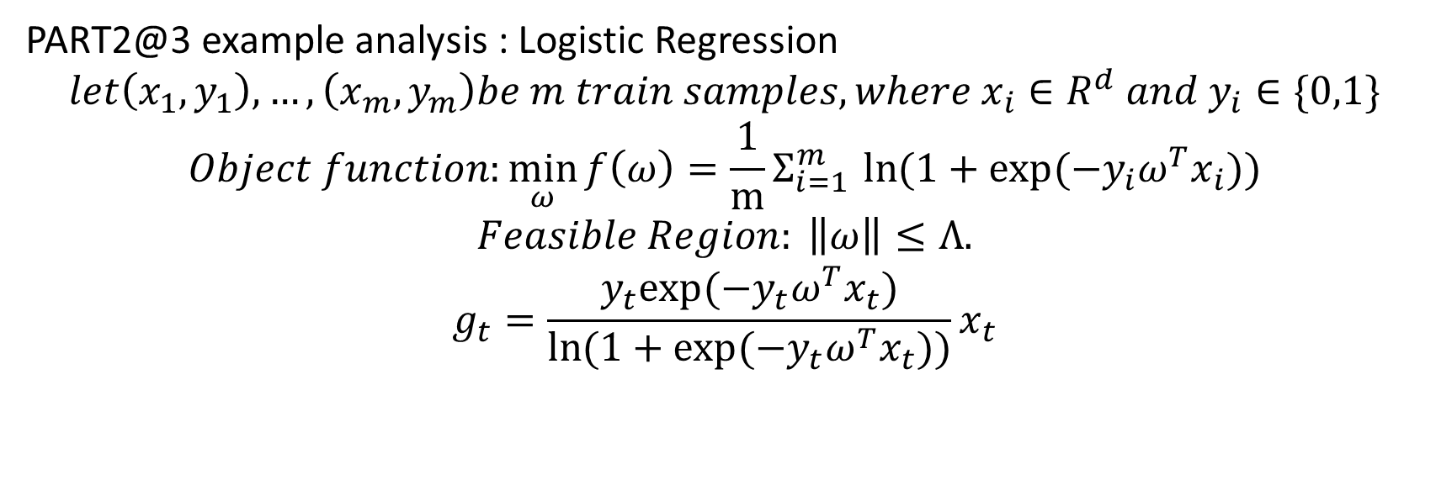
PART2@3 example analysis : Logistic Regression
$$let\left(x_{1},y_{1}\right),…,\left(x_{m},y_{m}\right)be m train samples,where x_{i}∈R^{d} and y_{i}∈\{0,1\}$$
$$Object function:\min_{ω}{f\left(ω\right)}={\frac{1}{m}Σ}_{i=1 }^{m}\ln{(1+exp⁡(−y_{i}ω^{T}x_{i}))}$$
$$Feasible Region: \left\|ω\right\|≤Λ.$$
$$g_{t}=\frac{y_{t}exp⁡(−y_{t}ω^{T}x_{t})}{\ln{(1+exp⁡(−y_{t}ω^{T}x_{t}))}}x_{t}$$
1:$randomly initialize ω_{1}∈\{ω|\left\|ω\right\|≤Λ\};$
2:$for t=1,……,T do$
3: $randomly sample a \left(x_{t},y_{t}\right)from training dataset$
4: $caculate stochastic−gradient g_{t}$
5: $Gradient Descent:ω_{t+1}^{′}=ω_{t}−η_{t}g_{t}$
6: $Projection:ω_{t+1}=Π_{W}\left(ω_{t+1}^{′}\right)=\frac{Λ}{max⁡(\left\|ω_{t+1}^{′}\right\|,Λ)}ω_{t+1}^{′}$
7:$end for$
8:$return \overline{ω_{T}}=\frac{1}{T}Σ_{t=1}^{T}ω_{t}$

Slide 36
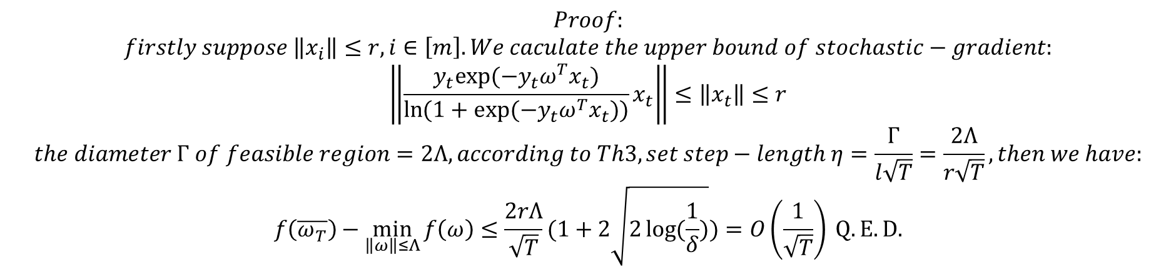
$$Proof:$$
$$firstly suppose \left\|x_{i}\right\|≤r, i∈\left[m\right]. We caculate the upper bound of stochastic−gradient:$$
$$\left\|\frac{y_{t}exp⁡(−y_{t}ω^{T}x_{t})}{\ln{(1+exp⁡(−y_{t}ω^{T}x_{t}))}}x_{t}\right\|≤\left\|x_{t}\right\|≤r$$
$$the diameter Γ of feasible region=2Λ, according to Th3, set step−length η=\frac{Γ}{l\sqrt{T}}=\frac{2Λ}{r\sqrt{T}},then we have:$$
$$f\left(\overline{ω_{T}}\right)−\min_{\left\|ω\right\|≤Λ}{f\left(ω\right)}≤\frac{2rΛ}{\sqrt{T}}(1+2\sqrt{2\log{(\frac{1}{δ})}})=O\left(\frac{1}{\sqrt{T}}\right) Q.E.D.$$

Slide 37
https://www.cnblogs.com/wuliytTaotao/archive/2019/12/01/11967620.html
http://mathgotchas.blogspot.com/2011/10/why-is-error-function-minimized-in.html LR的交叉熵是凸函数
https://stats.stackexchange.com/questions/106334/cost-function-of-neural-network-is-non-convex 神经网络的交叉熵不是凸函数

